Slide 1
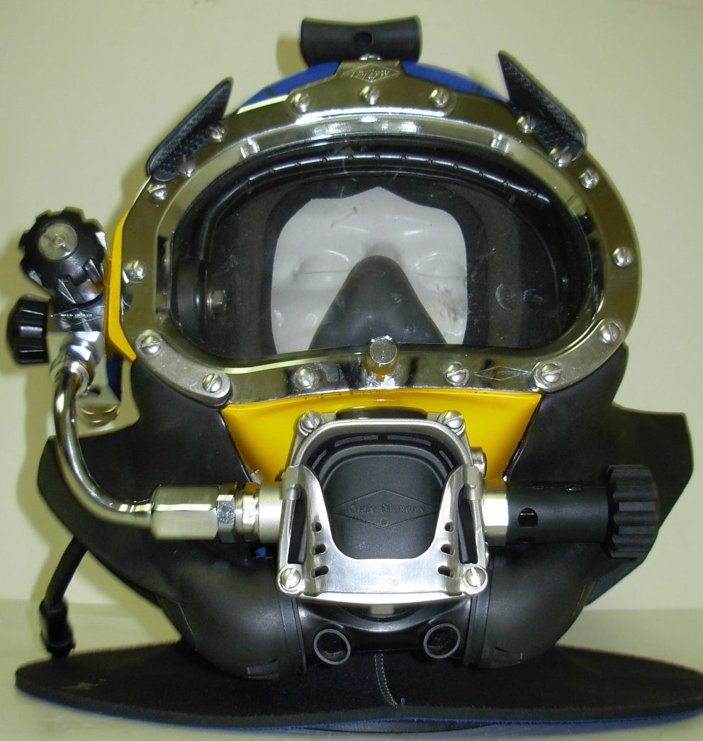
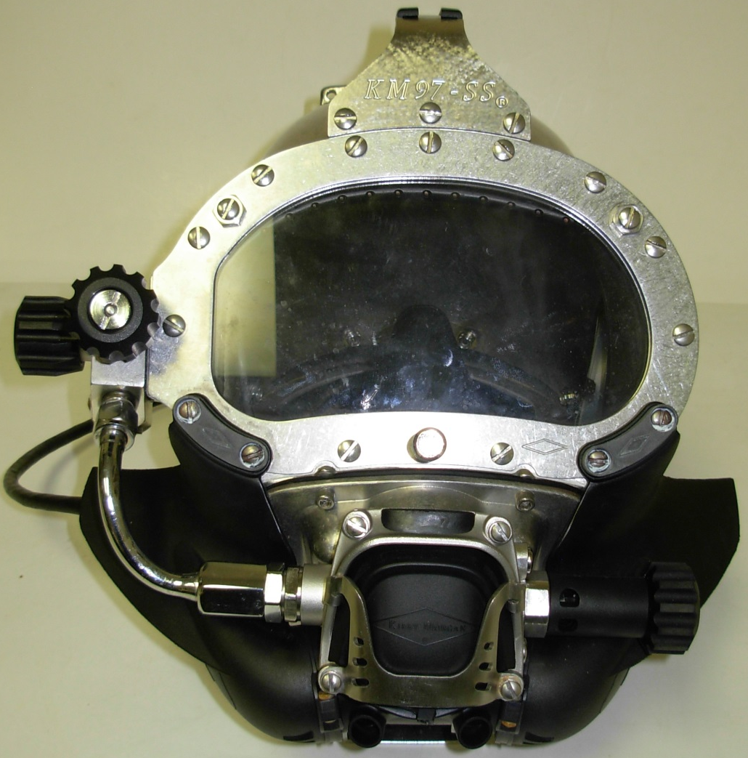
Super Flow 455 Stainless Regulator

Slide 2
KIRBY MORGAN DIVE SYSTEMS INCORPORATED MAINTENANCE AND REPAIR TECHNICIAN TRAINING
Only selected Dive Lab trained Technicians are authorized to teach the Technicians Course.
Only Dive Lab authorized Technicians may teach the KMDSI Operator/User Course.
Course curriculum must be presented within the guidelines set-up in the repair technician’s guide and slide show.
Kirby Morgan, SuperLite, Band Mask, KMB Band Mask, EXO, SuperMask, SuperFlow, and Rex are all registered trademarks of Kirby Morgan Dive Systems, Inc. Use of these terms to describe products that are not manufactured by KMDSI is not permitted without written permission from KMDSI.
© Copyright 1970-2009 Kirby Morgan Dive Systems, Inc. All rights reserved. This manual is made available for the express use of owner of this Kirby Morgan product. No part of this manual may be reproduced, stored in any retrieval system, or transmitted, or used in any form or by any means, whether graphic, electronic, mechanical, photocopy, or otherwise by technology known or unknown, without the prior written permission of Kirby Morgan Dive Systems, Inc.
THIS SLIDE SHOW IS FOR THE USE OF KIRBY MORGAN CUSTOMERS AND USERS OF KIRBY MORGAN DIVING EQUIPMENT ONLY. IT IS FREE OF CHARGE FROM OUR WEB SITES FOR THAT USE ONLY UNTIL FURTHER NOTICE. This material may not be reproduced for resale or given to unauthorized organizations or persons. THIS MATERIAL MAY NOT BE CHANGED OR MODIFIED WITHOUT WRITTEN PERMISSION.
Prepared by Dive Lab®, Inc. 1415 Moylan Road, Panama City Beach, FL 32407 USA
Telephone: (850) 235-2715 Web Site: www.divelab.com E-Mail: divelab@aol..com
Document #TechTrnG 03101

Slide 3
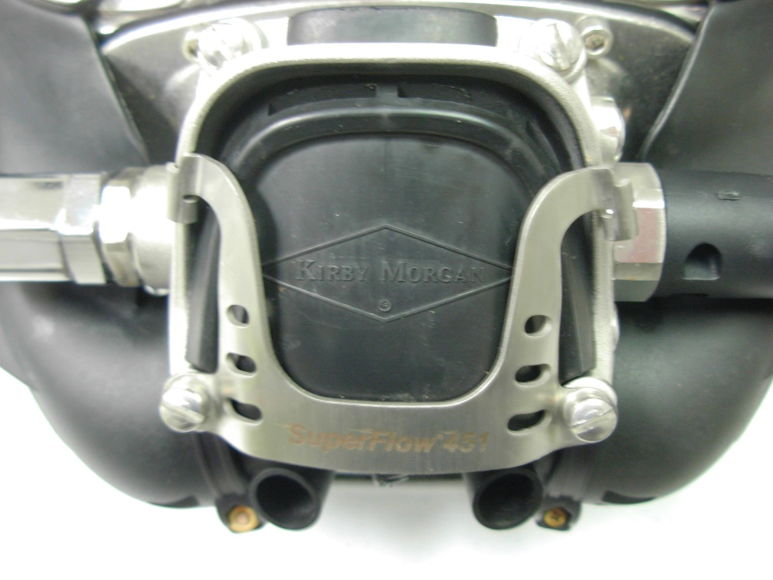
Super Flow 455 Stainless Balanced Regulator
Super Flow 455 is a high performance regulator from Kirby Morgan
Cast stainless steel regulator body, stainless steel internal parts
For adjustment and proper function of regulator, supply pressure of 135 to 150 psi should be used

Slide 4
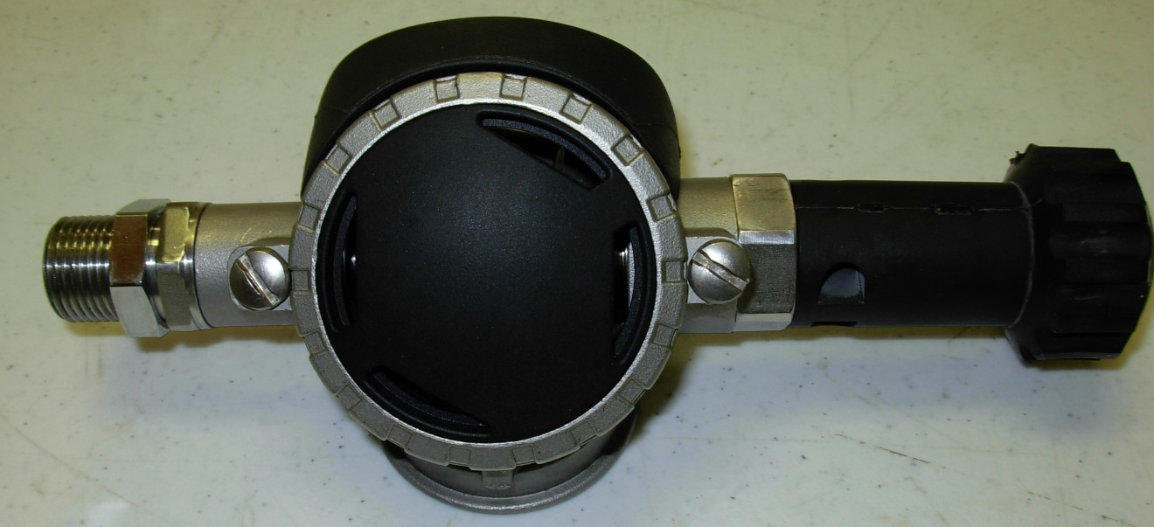
Super Flow 455
SF455 is the next step in the evolution of the SF450
(better performance)
SF455 is CE certified
2014
Super Flow 450
First cast Stainless Steel regulator
SF450 is NOT CE certified
2005

Slide 5
Super Flow 455 Stainless Balanced Regulator
Will fit on : SL17C,K,27,37,37SS, 57,MK21,KMB18, KMB28
Standard on KM97

Slide 6
Super Flow 455
KMB18&28
Will fit KMB18s manufactured after Jan 1999
Will fit KMB 28s manufactured after June 2004
Masks switched from a small tube to a large tube regulator (SF350) after the above dates

Slide 7
Super Flow 455
SL27
Is a direct fit
Older 27s may require sanding around the nose area of the helmet shell

Slide 8
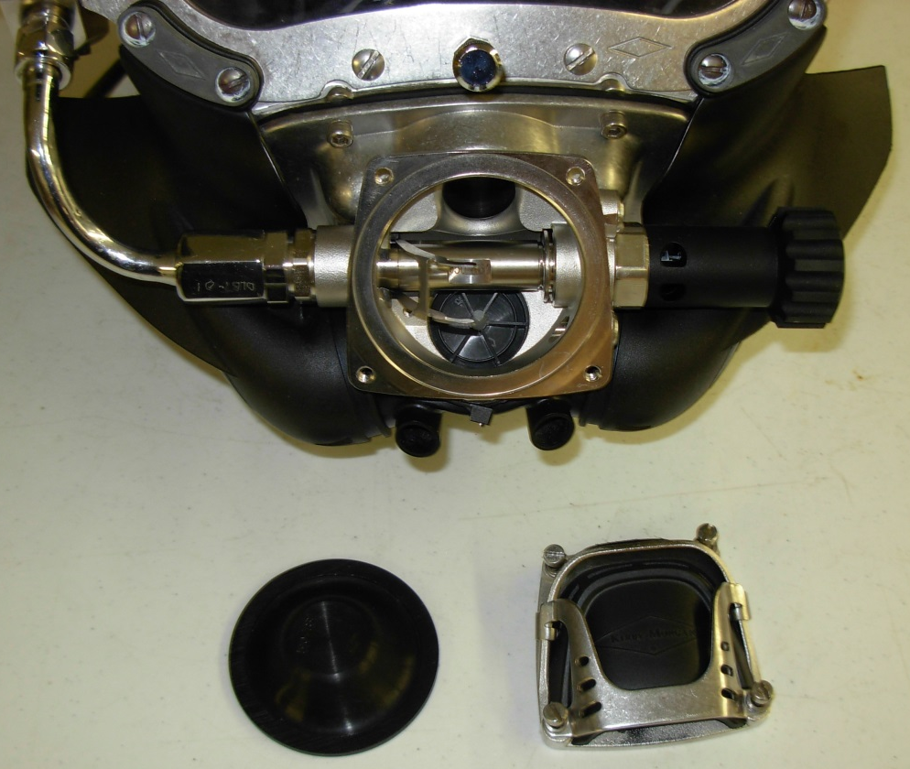
Super Flow 455 Disassembly
Loosen screws on regulator cover, do not remove screws from cover
Remove cover and diaphragm, inspect diaphragm for holes or tears

Slide 9
Super Flow 455
Inspect interior of regulator for foreign matter and remove if necessary
Check regulator exhaust valve for warping, distortion, stiffness, and or damage
Check exhaust valve seat spokes for damage
If any damage present replace components

Slide 10
Super Flow 455 Adjustments
Reinstall the diaphragm and cover assembly
Tighten screws 15 to 18 inch pounds

Slide 11
Super Flow 455
Check regulator for adjustment and proper function with the assembly complete, and supplied with a breathing gas supply pressure of between 135 to 150 psig

Slide 12
Super Flow 455
Rotate flex knob in, clockwise towards the regulator body, until a clicking can be heard with each full turn of the knob
This is an audible indication the tension of the bias adjustment spring is as tight as it will get
The adjustment knob will never bottom out or stop turning in this direction and no damage to the mechanism will occur
The clicking is an audible indication the adjustment knob is fully positioned in

Slide 13
Super Flow 455
You have the option of connecting gas supply two different ways

Slide 14
Super Flow 455
Connect gas supply two different ways
#1 connect gas supply through side block
EGS valve or umbilical connection

Slide 15
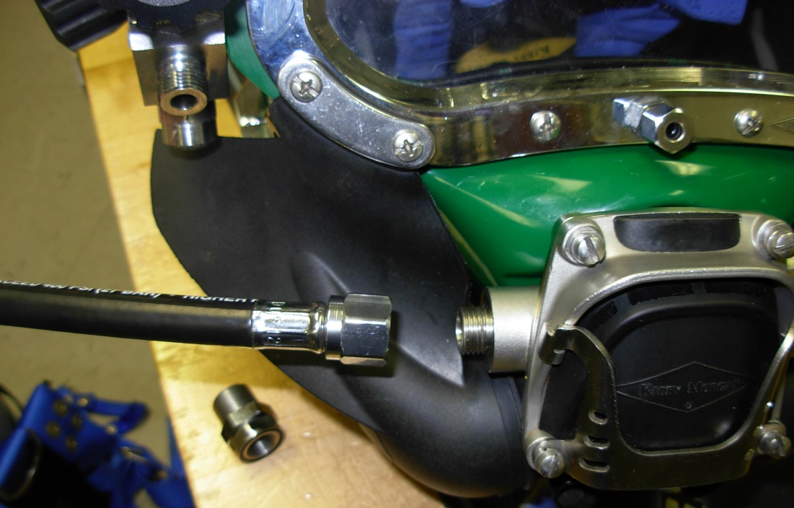
Super Flow 455
Connect gas supply two different ways
#2 connect gas supply using a 9/16 scuba fitting
Bail-out set used quite often for this

Slide 16
Super Flow 455
Turn on gas supply
Rotate the Flex Knob out counterclockwise slowly, three full turns
Lightly depress the regulator purge cover several times and ensure the gas flow is stable

Slide 17
Super Flow 455
Push in gently on the cover of the regulator
There should be 1/8"–1/4" free travel in the cover before gas flow starts
When the cover is fully depressed, a strong surge of gas must be heard

Slide 18
Super Flow 455
If the purge cover has NO play, or play is greater than 1/4" before GAS flow is heard, the demand regulator requires internal adjustment

Slide 19
Super Flow 455
Turn off the air supply and bleed off the pressure and remove the supply hose to expose the adjustment nipple
Insert a flat head screwdriver into slot in the end of the adjustment nipple to make adjustments as may be necessary

Slide 20
Super Flow 455
If there is too much play in the lever, the adjustable nipple will need to be turned out (counter clockwise)
Too little play, the nipple will need to be turned in
Whatever direction is needed, make the adjustment in very small increments and re-check
Usually 1/16 turn at a time or less of a turn will suffice

Slide 21
Super Flow 455
Re-connect air supply and re-check, (repeat as necessary) until required play is obtained
Adjustments are complete, reconnect bent tube adapter and bent tube

Slide 22
Super Flow 455
Regulator is adjusted and ready for use

Slide 23
Summary
Always refer to Operations & maintenance manual for adjustment procedures
Helmet Models
Inspection
Adjustments

Slide 24



