Slide 1
All Models of KMDSI Helmets

Slide 2
KIRBY MORGAN DIVE SYSTEMS INCORPORATED MAINTENANCE AND REPAIR TECHNICIAN TRAINING
Only selected Dive Lab trained Technicians are authorized to teach the Technicians Course.
Only Dive Lab authorized Technicians may teach the KMDSI Operator/User Course.
Course curriculum must be presented within the guidelines set-up in the repair technician’s guide and slide show.
Kirby Morgan, SuperLite, Band Mask, KMB Band Mask, EXO, SuperMask, SuperFlow, and Rex are all registered trademarks of Kirby Morgan Dive Systems, Inc. Use of these terms to describe products that are not manufactured by KMDSI is not permitted without written permission from KMDSI.
© Copyright 1970-2009 Kirby Morgan Dive Systems, Inc. All rights reserved. This manual is made available for the express use of owner of this Kirby Morgan product. No part of this manual may be reproduced, stored in any retrieval system, or transmitted, or used in any form or by any means, whether graphic, electronic, mechanical, photocopy, or otherwise by technology known or unknown, without the prior written permission of Kirby Morgan Dive Systems, Inc.
THIS SLIDE SHOW IS FOR THE USE OF KIRBY MORGAN CUSTOMERS AND USERS OF KIRBY MORGAN DIVING EQUIPMENT ONLY. IT IS FREE OF CHARGE FROM OUR WEB SITES FOR THAT USE ONLY UNTIL FURTHER NOTICE. This material may not be reproduced for resale or given to unauthorized organizations or persons. THIS MATERIAL MAY NOT BE CHANGED OR MODIFIED WITHOUT WRITTEN PERMISSION.
Prepared by Dive Lab®, Inc. 1415 Moylan Road, Panama City Beach, FL 32407 USA
Telephone: (850) 235-2715 Web Site: www.divelab.com E-Mail: divelab@aol..com
Document #TechTrnG 03101

Slide 3
All Models of KMDSI Helmets
Visually inspect helmet shell exterior for loose or missing fasteners, Fiberglass & Stainless Steel helmets
Inspect Stainless Steel helmets for staining or surface rust (clean in accordance manual

Slide 4
All Models of KMDSI Helmets
Inspect for:
Obvious signs of fiberglass damage; including cracks, gouges, and or depressions

Slide 5
All Models of KMDSI Helmets
Any gouges deeper than 1/16” (1.5mm) should be repaired
Fiberglass and gel coat repairs must be completed by a technician that has received certification for Helmet Shell repairs by KMDSI or Dive Lab, Inc.

Slide 6
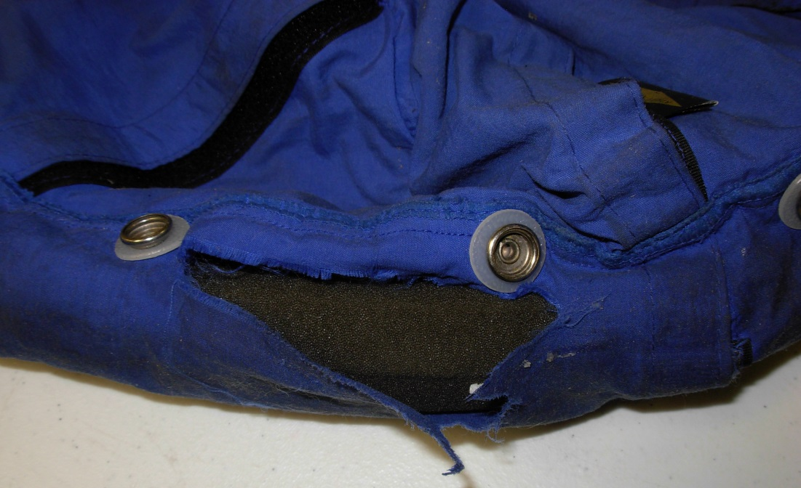
All Models of KMDSI Helmets
Remove Helmet Liner, inspect liner fabric for tears, broken snaps and chin strap damage (17A/B)

Slide 7
All Models of KMDSI Helmets
Inspect the Head and Chin foam for signs of crumbling/rotting
Replace if required, Guidance O & M Manual

Slide 8
All Models of KMDSI Helmets
Important to have a properly fitted Head Liner and always use the Chin Strap and Snaps
Replace Foam when worn, in order to maintain a proper “snug” fit, so that a good Oral Nasal seal is obtained

Slide 9
All Models of KMDSI Helmets
A poor seal can result in CO₂ build-up, (When the divers head turns, the helmet should follow)
Foam can be custom cut to accommodate different size heads

Slide 10
All Models of KMDSI Helmets
Ensure all snaps are in good condition, operable and all are used

Slide 11
All Models of KMDSI Helmets
The main causes of CO₂ build up in any Demand Mode Helmet:
Poor Oral Nasal Mask seal
High breathing resistance resulting from improper regulator adjustment
Diving beyond the performance capability of the equipment or the system supporting the equipment

Slide 12
All Models of KMDSI Helmets
Remove Earphones from their holders, remove the covers from the Earphones, inspect for corrosion and damage
Clean repair or replace as necessary
Remove the Microphone from the Oral Nasal Mask, remove the Cover from the Microphone and inspect
Check wire connections, solder joints, they should be solid and no corrosion

Slide 13
All Models of KMDSI Helmets
If the Mylar is torn or loose, the speaker should be replaced
The speakers are chrome plated to resist corrosion
Mylar speakers last longer than cardboard type
Guidance O&M Manual

Slide 14
Top Ten Reasons Communication systems Fail
Corrosion
Mismatched components
Short circuit
Communication posts
Crossed wire connection
Communication box
Umbilical comm wire
Broken wires/Strands
Flooded connections
Solder joints
Notes:
Conduct continuity check on complete system
Match all components
Keep clean

Slide 15
#1 Reason Communication systems Fail
Corrosion
Notes:
Conduct continuity check on complete system
Match all components
Keep clean

Slide 16
All Models of KMDSI Helmets
Remove the Nose-Clearing Device, clean and inspect the Nose-Clearing Pad, and Shaft
Guidance O&M Manual

Slide 17
All Models of KMDSI Helmets
Shape of device may be altered to fit by adding padding and or bending the V plate
Check for worn O-rings

Slide 18
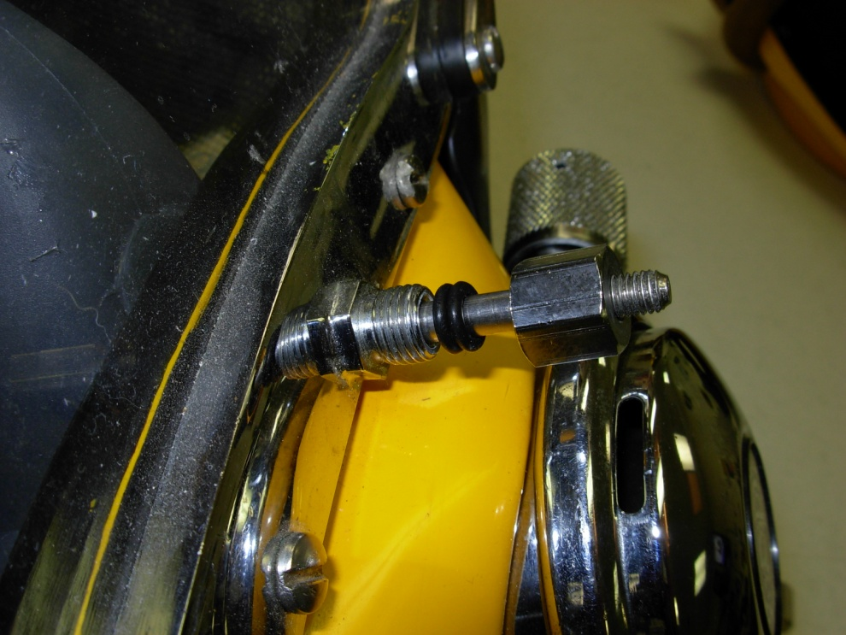
All Models of KMDSI Helmets
Lightly lubricate o-rings
Complete assembly

Slide 19
All Models of KMDSI Helmets
Remove Oral Nasal Mask as an assembly, clean the Valve and the Valve Body as an assembly
Clean the Oral Nasal Mask
Inspect mask and valve assembly for damage and deterioration

Slide 20
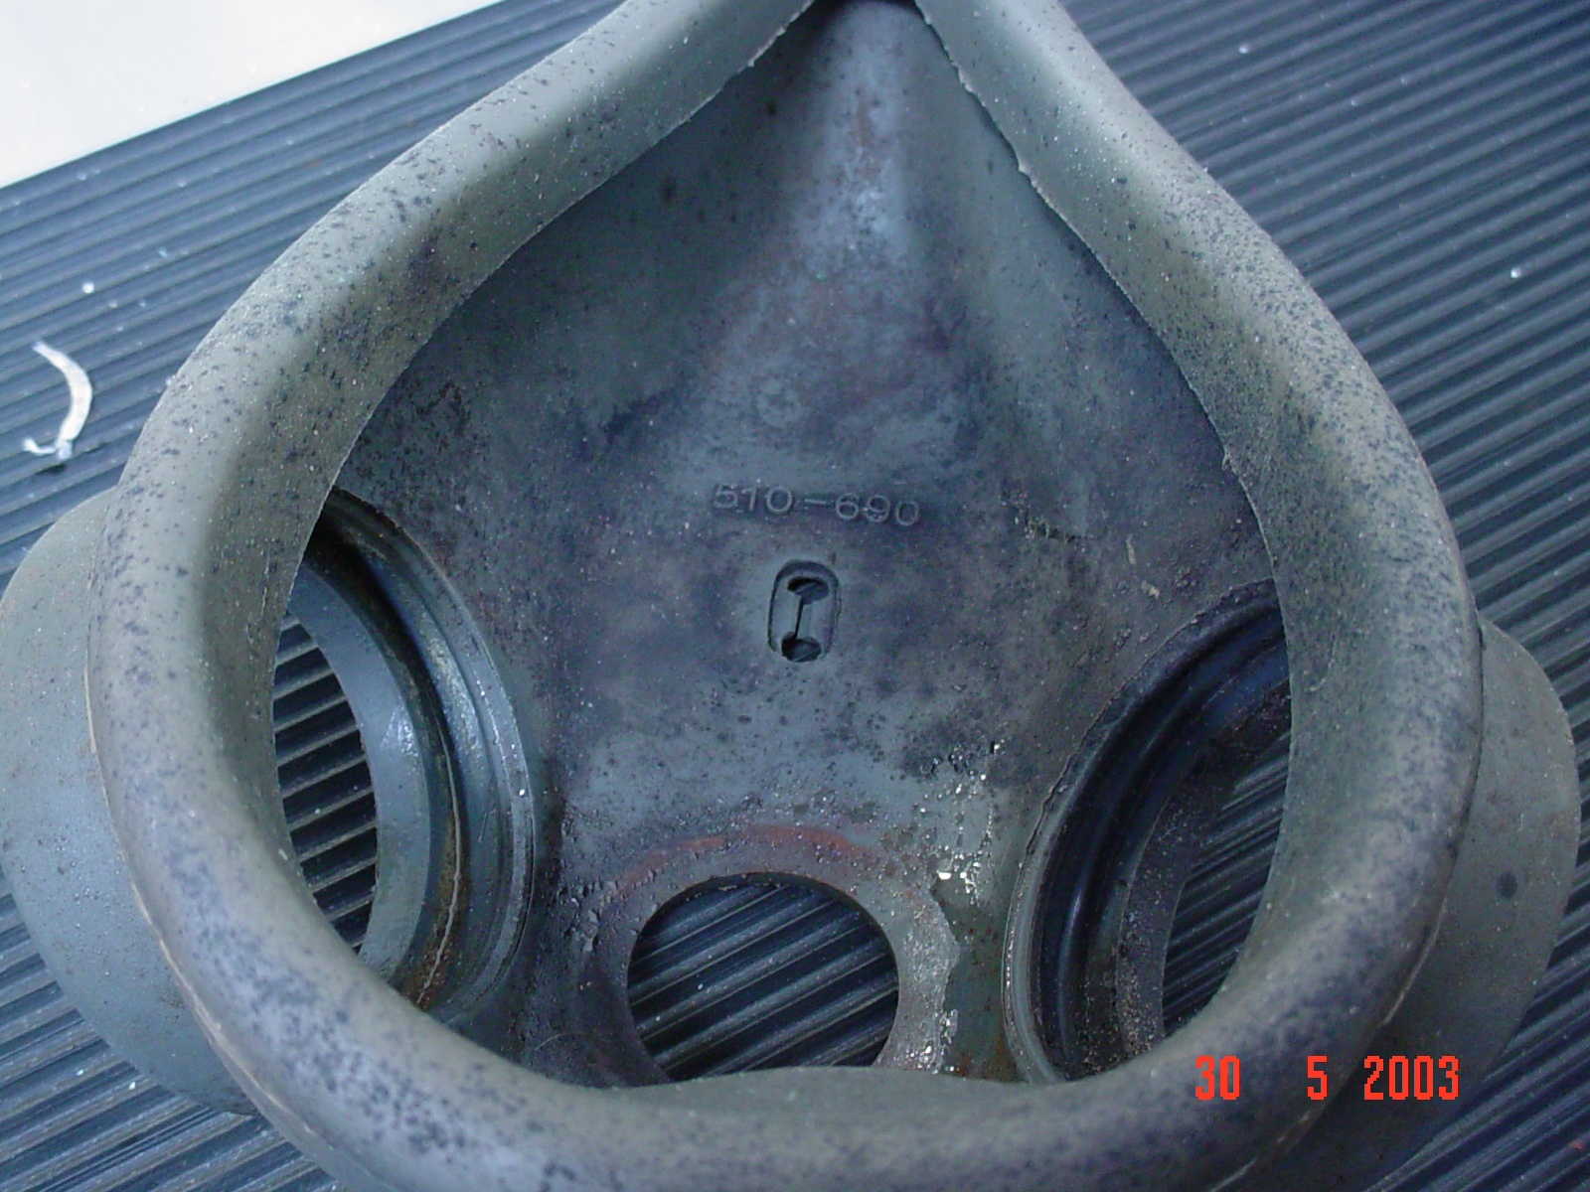
Oral Nasal Mask

Slide 21
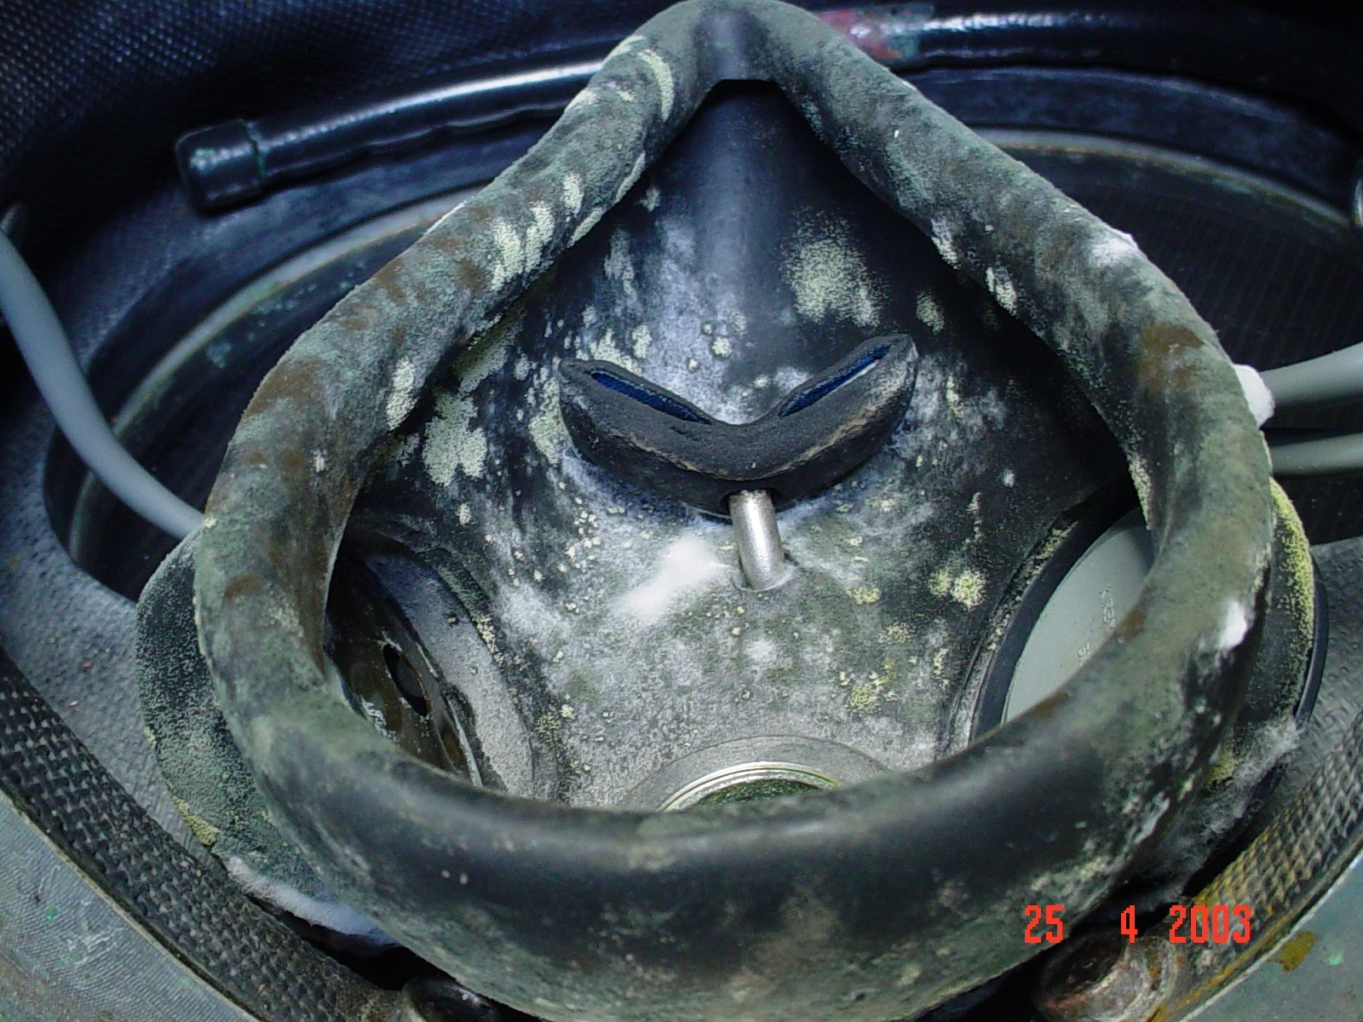
Oral Nasal Mask

Slide 22
All Models of KMDSI Helmets
Replace mask if any damage is found
Replace the Oral Nasal Valve, if Valve appears dried or stiff or does not lay flat
Clean and inspect the Nose Clearing Pad, Shaft, and O-rings for wear

Slide 23
All Models of KMDSI Helmets
Reinstall Oral Nasal Mask and Valve Assembly
Guidance O & M Manual

Slide 24
All Models of KMDSI Helmets
Dangers regarding improper fit or no use of Oral-Nasal
Installation of Oral-Nasal Valve and reasons why the Valve opens into the Mask
Types of wear and damage the Valve may have

Slide 25
Oral/Nasal Valve
Correct valve installation
Incorrect valve installation

Slide 26
All Models of KMDSI Helmets
Without air to the Helmet, check the operation of the defogger and auxiliary gas (EGS) Valve
If Valves do not operate smooth and easy, the valves should be serviced or overhauled by an authorized KMDSI Technician
Guidance O&M Manuals

Slide 27
All Models of KMDSI Helmets
Valves often get neglected and the Knob(s) get worn or damaged from “Gorilla Griping”
Valve stems will bend
Replace if damaged

Slide 28
All Models of KMDSI Helmets
Check the rotational play of the Emergency and Steady Flow Valves
Flats in the Knobs and the flats on the Stem get worn when the Valves become hard to turn, due to lack of service

Slide 29
All Models of KMDSI Helmets
Once a month remove Main Exhaust Water Dump Valve Cover, on the SL-17A/B, K, C, KM37, 57 Helmets
Cover is held in place by two screws remove the Cover, clean and inspect the Flapper Valve and Seating Surface

Slide 30
All Models of KMDSI Helmets
17B/A original water dump valve
Quad Valve configuration

Slide 31
KM37SS & KM97 Main Exhaust/Water dump
Once a month inspect Main Exhaust/Water Dump Valve on KM37SS, 97 Helmets
Main Exhaust/Water dump valve can only be accessed from inside the helmet on KM37SS and KM97 helmets

Slide 32
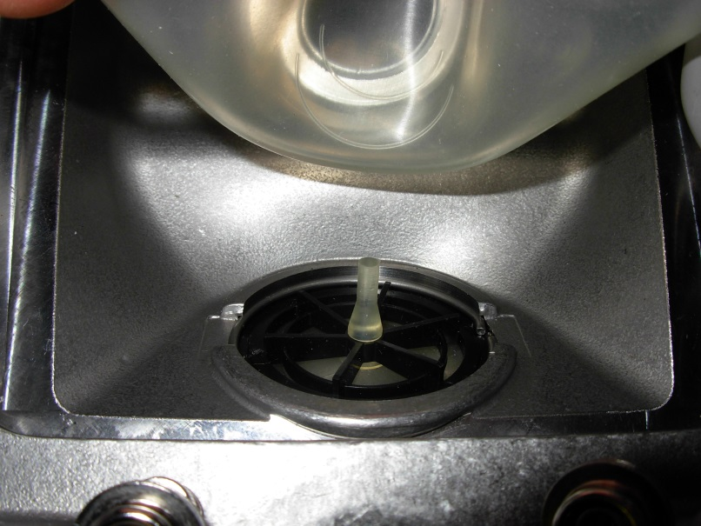
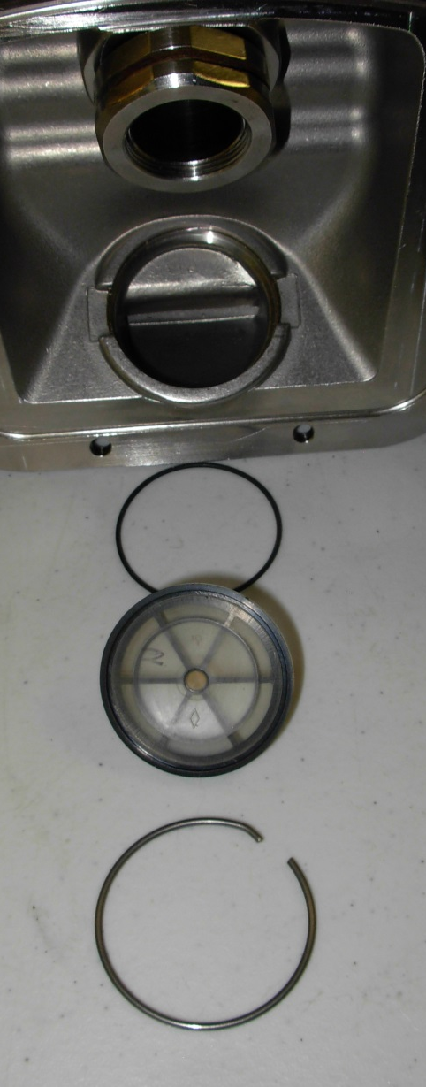
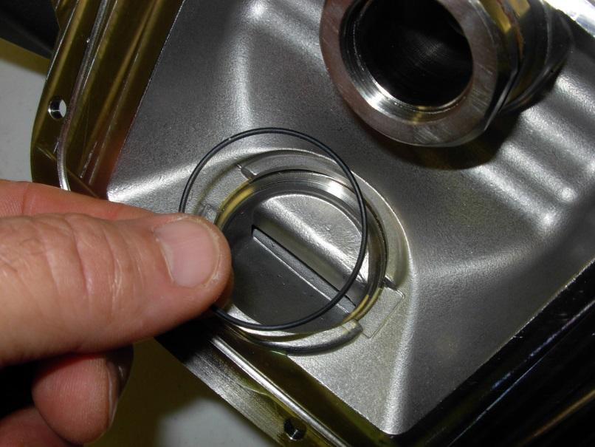
KM37SS & KM97 Main Exhaust/Water dump

Slide 33
All Models of KMDSI Helmets
On the SL-27, the Water Dump is on the left side next to the Regulator
The rubber Shroud needs to be removed by cutting the tie wrap before the Valve can be inspected
Clean and inspect the Valve, and replace the Valve if dried or damaged or does not lie flat
Install a new tie wrap (SL-27 only)

Slide 34
All Models of KMDSI Helmets
SL 27 water dump is located on the left cheek

Slide 35
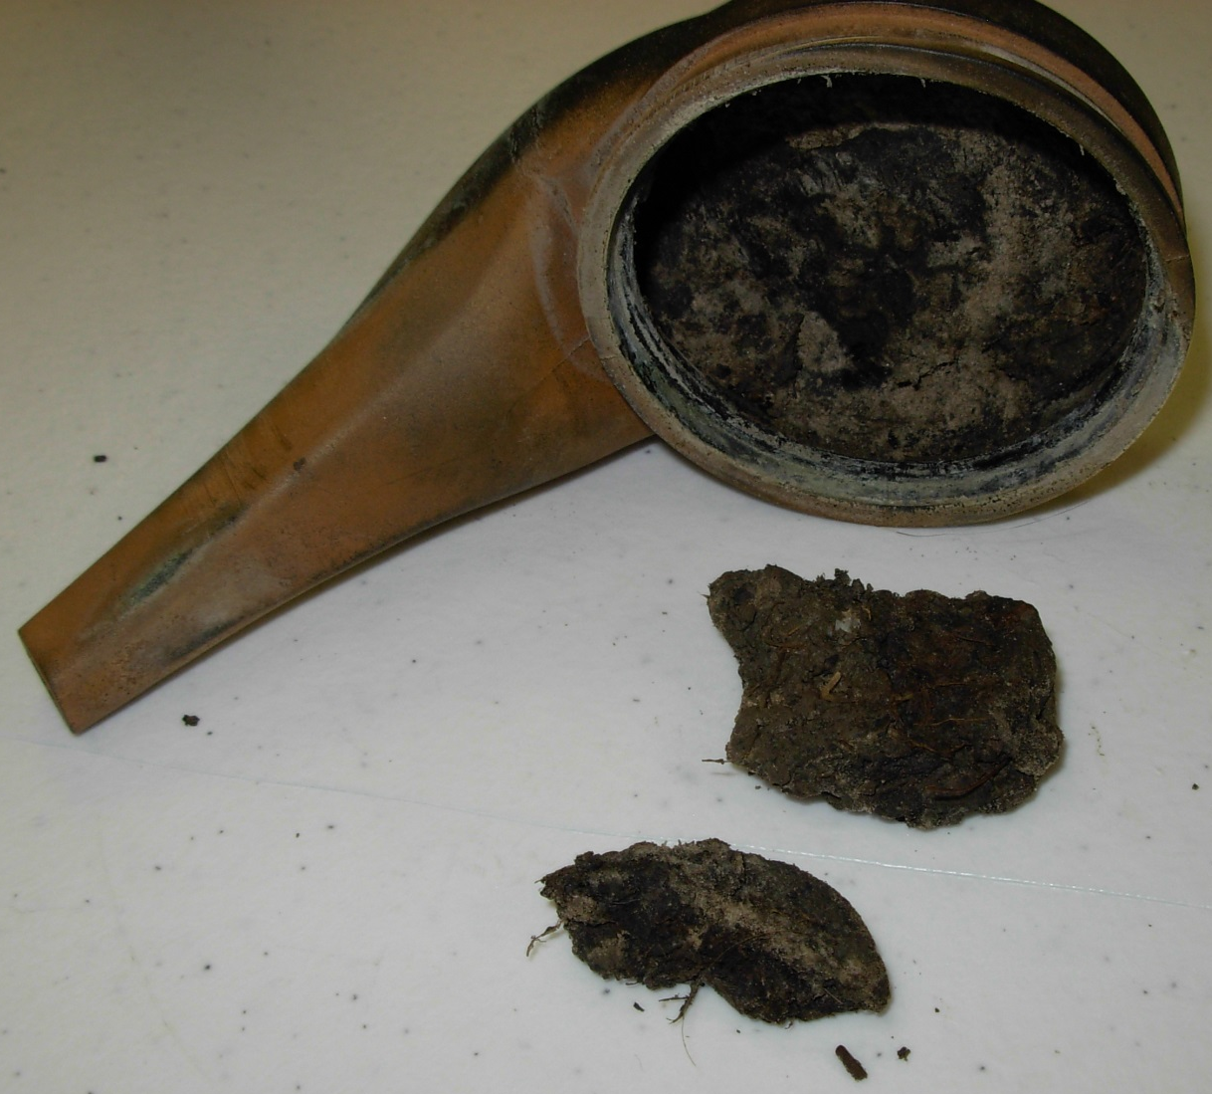
All Models of KMDSI Helmets
Exhaust/water dump valves should never look like this

Slide 36
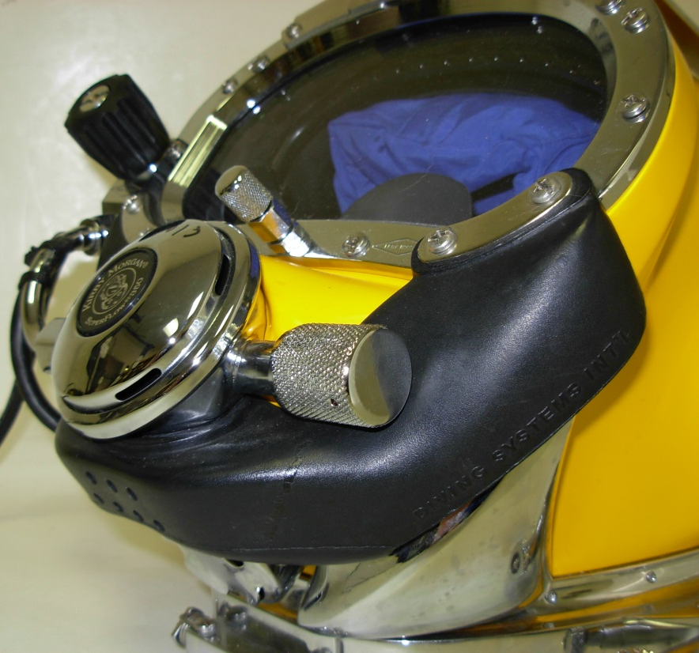
All Models of KMDSI Helmets
Inspect exhaust shroud and or whiskers, replace if necessary
Guidance O&M Manual

Slide 37
All Models of KMDSI Helmets
Inspect exhaust valve “Seating / Sealing Surface” it is important in keeping the seating surface clean and free of corrosion

Slide 38
All Models of KMDSI Helmets
Do not lubricate the Flapper Valves: dirt can stick to the surfaces of Flapper Valves that have been lubricated causing leakage

Slide 39
All Models of KMDSI Helmets
Only use KMDSI Valves when conducting repairs (Do not substitute Parts)
Use of wrong Valve can cause Helmet flooding and/or poor breathing performance
Helmet will free flow and or leak if this Valve is not in good condition

Slide 40
All Models of KMDSI Helmets
Do not use helmet without shroud on the SL-27 main / Water Dump Valve
The Shroud allows the Water Dump Valve to sense the same pressure as the demand Regulator, keeping the Helmet from free flowing

Slide 41
Exhaust/Dewatering System
Old Double Exhaust Whisker (Latex) two Exhaust valves, integrated water dump, first “contaminated water exhaust system” fits: SL17A,B,C,K, KM37,57

Slide 42
Exhaust/Dewatering System
Old Double Exhaust Whisker (Latex) two Exhaust valves, integrated water dump, “contaminated water exhaust system” fits: SL27

Slide 43
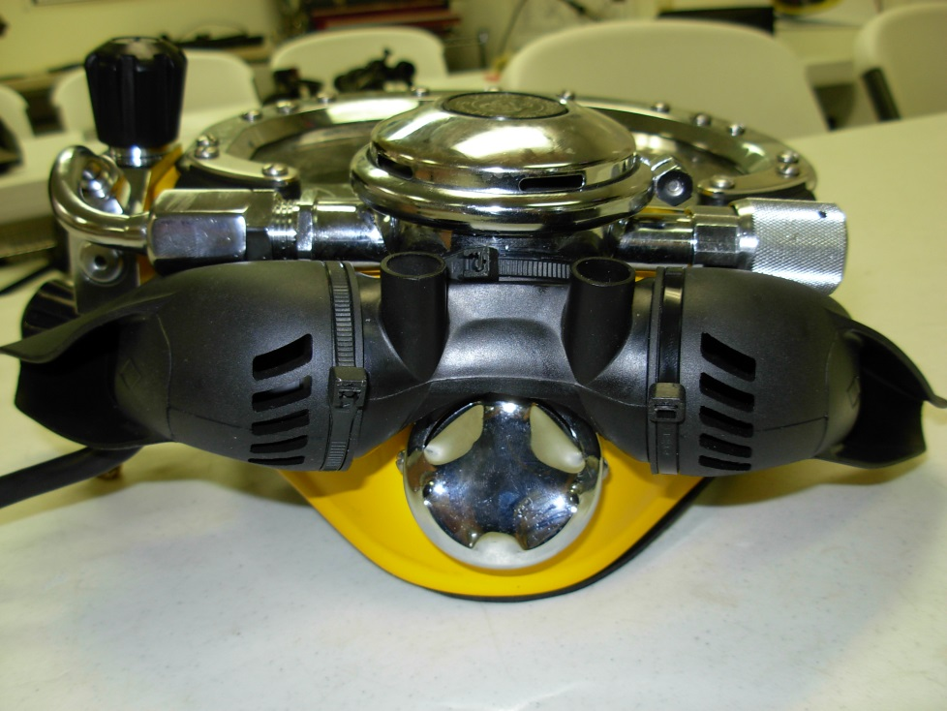
Exhaust/Dewatering System
Tri-valve, Three exhaust Valves , Standard on SL27 and 18/28, will fit on older 18/28 band mask
Whisker Wings

Slide 44
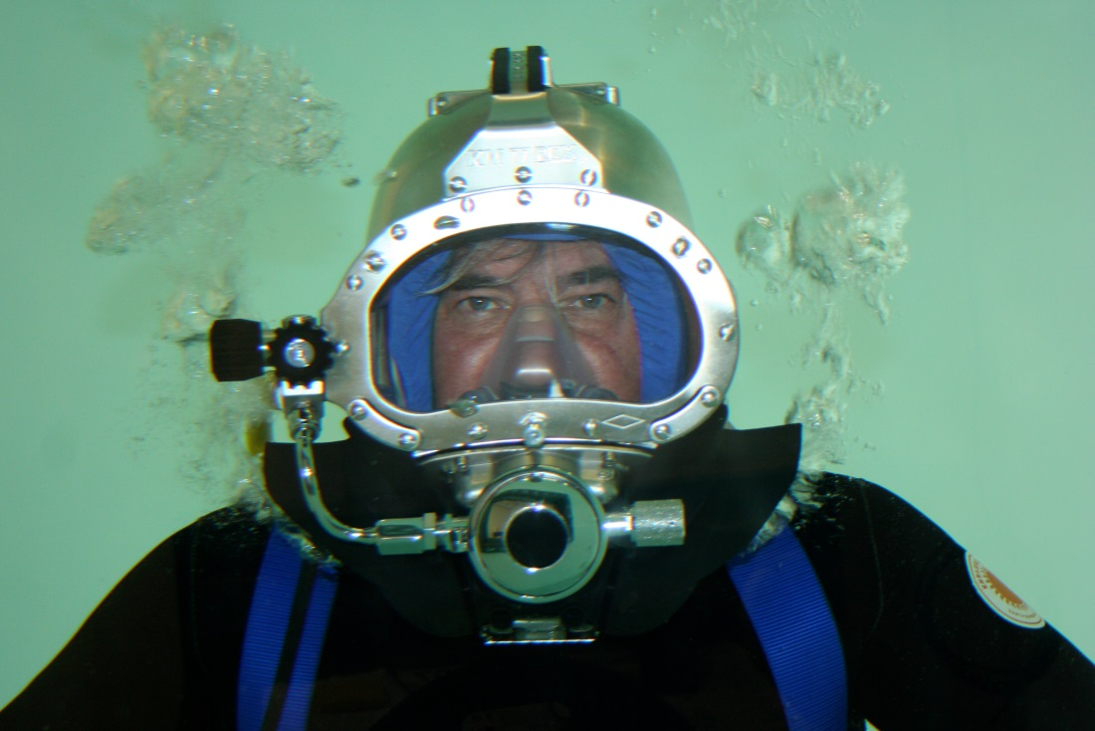
Exhaust/Dewatering System
Quad-Valve, four exhaust valves, standard on: SL17B, KM37/SS,57,97 will fit on 17A,C,K (Recommended for diving in water with unknown contaminates)

Slide 45



