Slide 1
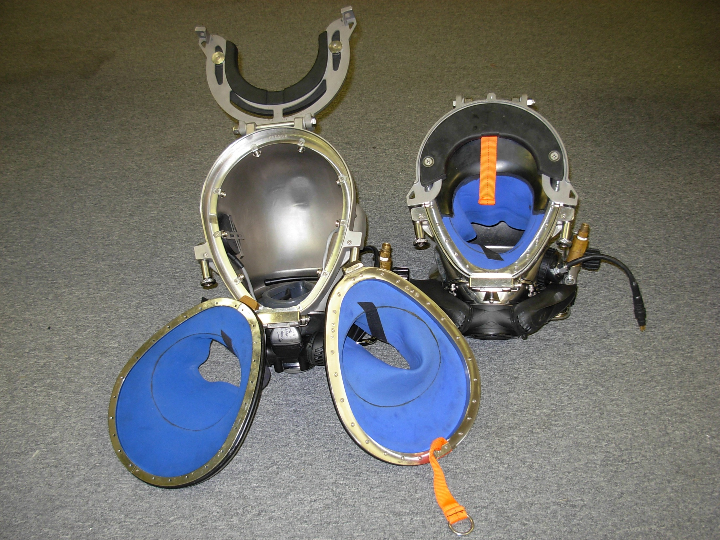
SL17C,K,27,KM37/SS,47,57,77, 97 Neck Ring / Assembly

Slide 2
KIRBY MORGAN DIVE SYSTEMS INCORPORATED MAINTENANCE AND REPAIR TECHNICIAN TRAINING
Only selected Dive Lab trained Technicians are authorized to teach the Technicians Course.
Only Dive Lab authorized Technicians may teach the KMDSI Operator/User Course.
Course curriculum must be presented within the guidelines set-up in the repair technician’s guide and slide show.
Kirby Morgan, SuperLite, Band Mask, KMB Band Mask, EXO, SuperMask, SuperFlow, and Rex are all registered trademarks of Kirby Morgan Dive Systems, Inc. Use of these terms to describe products that are not manufactured by KMDSI is not permitted without written permission from KMDSI.
© Copyright 1970-2009 Kirby Morgan Dive Systems, Inc. All rights reserved. This manual is made available for the express use of owner of this Kirby Morgan product. No part of this manual may be reproduced, stored in any retrieval system, or transmitted, or used in any form or by any means, whether graphic, electronic, mechanical, photocopy, or otherwise by technology known or unknown, without the prior written permission of Kirby Morgan Dive Systems, Inc.
THIS SLIDE SHOW IS FOR THE USE OF KIRBY MORGAN CUSTOMERS AND USERS OF KIRBY MORGAN DIVING EQUIPMENT ONLY. IT IS FREE OF CHARGE FROM OUR WEB SITES FOR THAT USE ONLY UNTIL FURTHER NOTICE. This material may not be reproduced for resale or given to unauthorized organizations or persons. THIS MATERIAL MAY NOT BE CHANGED OR MODIFIED WITHOUT WRITTEN PERMISSION.
Prepared by Dive Lab®, Inc. 1415 Moylan Road, Panama City Beach, FL 32407 USA
Telephone: (850) 235-2715 Web Site: www.divelab.com E-Mail: divelab@aol..com
Document #TechTrnG 03101

Slide 3
SL17C,K,27,KM37/SS,47,57,77,97 Neck Ring / Assembly
Neck Ring/Dam components of the SL17C, K/27, KM-37/SS, 47, 57, 77, and 97 are virtually identical and use the same components
When performing maintenance or repairs refer to the specific manual for the helmet being serviced

Slide 4
SL17C,K,27,KM37/SS,47,57,77,97 Neck Ring / Assembly
Visually inspect all metal parts of the Helmet Locking Collar assembly for damage
Check the Locking Collar for misalignment and/or loose fasteners

Slide 5
SL17C,K,27,KM37/SS,47,57,77,97 Neck Ring / Assembly
Ensure the locking collar smoothly engages the sealed pull pins without binding or rubbing
Check for excessive side play, side play should be no greater than 5/64 (2.0 mm)

Slide 6
SL17C,K,27,KM37/SS,47,57,77,97 Neck Ring / Assembly
Inspect Neck Pad, Washers, and “T”-Washers in the recesses of the Neck Pad
Ensure screws are not loose or missing
Guidance O & M Manual

Slide 7
SL17C,K,27,KM37/SS,47,57,77,97 Neck Ring / Assembly
Visually inspect the two Sealed Pull Pins to ensure they operate smoothly and
engage the Locking Collar Properly
Ensure the Sealed Pull Pins are not bent or damaged in any way

Slide 8
SL17C,K,27,KM37/SS,47,57,77,97 Neck Ring / Assembly
Caution:
The cam angle must be correct for the Pull Pins to operate properly
Angle facing down

Slide 9
SL17C,K,27,KM37/SS,47,57,77,97 Neck Ring / Assembly
Very early SL-27 Pins were not oil filled sealed units
Discontinued in early 90s

Slide 10
SL17C,K,27,KM37/SS,47,57,77,97 Neck Ring / Assembly
Current model
Filled with Dow Corning 550R Silicone oil

Slide 11
SL17C,K,27,KM37/SS,47,57,77,97 Neck Ring / Assembly
DANGER:
If Sealed Pull Pins do not operate correctly, the helmet could come off underwater
OR
They do not release properly, could make it difficult to remove the helmet in a timely manner

Slide 12
SL17C,K,27,KM37/SS,47,57,77,97 Neck Ring / Assembly
CAUTION:
If Sealed Pull Pins stick or do not provide adequate tension, it is essential to return the Helmet to an authorized KMDSI Dealer for service
DO NOT attempt to service the Sealed Pull Pins

Slide 13
SL17C,K,27,KM37/SS,47,57,77,97 Neck Ring / Assembly
Damaged or worn Pull Pins must be repaired by a trained technician

Slide 14
SL17C,K,27,KM37/SS,47,57,77,97 Neck Ring / Assembly
Visually inspect the metal ring (Helmet Ring) at the base of the Helmet for damage to the sealing surface

Slide 15
SL17C,K,27,KM37/SS,47,57,77,97 Neck Ring / Assembly
If bent or damaged it should only be repaired by an authorized KMDSI repair facility

Slide 16
SL17C,K,27,KM37/SS,47,57,77,97 Neck Ring / Assembly
Check the Swing Tongue Catch for proper operation
Check for loose, worn or damaged parts
Guidance O&M Manual

Slide 17
SL17C,K,27,KM37/SS,47,57,77,97 Neck Ring / Assembly
Test mate, then remove the Neck Dam Ring Assembly / Locking Collar from the Helmet
Check for proper Pull Pin alignment and smooth operation

Slide 18
SL17C,K,27,KM37/SS,47,57,77,97 Neck Ring / Assembly
Inspect Neck Dam Ring, for contamination (Dirt/Mud) and damage

Slide 19
SL17C,K,27,KM37/SS,47,57,77,97 Neck Ring / Assembly
Clean and lubricate the O-ring mating surface, then mate Neck Ring / Dam assembly
Assembly should fit into the Helmet Ring smoothly and should not require extraordinary force, other than what is required to overcome the O-ring friction
If extra force is required this would indicate a damaged, bent or deformed Neck Ring

Slide 20
SL17C,K,27,KM37/SS,47,57,77,97 Neck Ring / Assembly
There should not be portions of the O-ring visibly present on exterior of the Neck Dam Ring once engaged on the Helmet Ring
If any of the o-ring is visible that would indicate a stretched/damaged Neck Dam Ring O-ring

Slide 21
SL17C,K,27,KM37/SS,47,57,77,97 Neck Ring / Assembly
Inspect the Chin Strap to insure it works properly and is not torn or damaged
Check to insure the fasteners are installed

Slide 22
SL17C,K,27,KM37/SS,47,57,77,97 Neck Ring / Assembly
Insure all the Neck Dam Components work smoothly
Old style external chin strap, early SL27 and SL17K no longer in production

Slide 23
SL17C,K,27,KM37/SS,47,57,77,97 Neck Ring / Assembly
Inspect and adjust the Neck Slide Locking Collar
Should be adjusted for the individual using the hat
Ideally one finger gap between back of neck and locking collar

Slide 24
SL17C,K,27,KM37/SS,47,57,77,97 Neck Ring / Assembly
?

