Slide 1
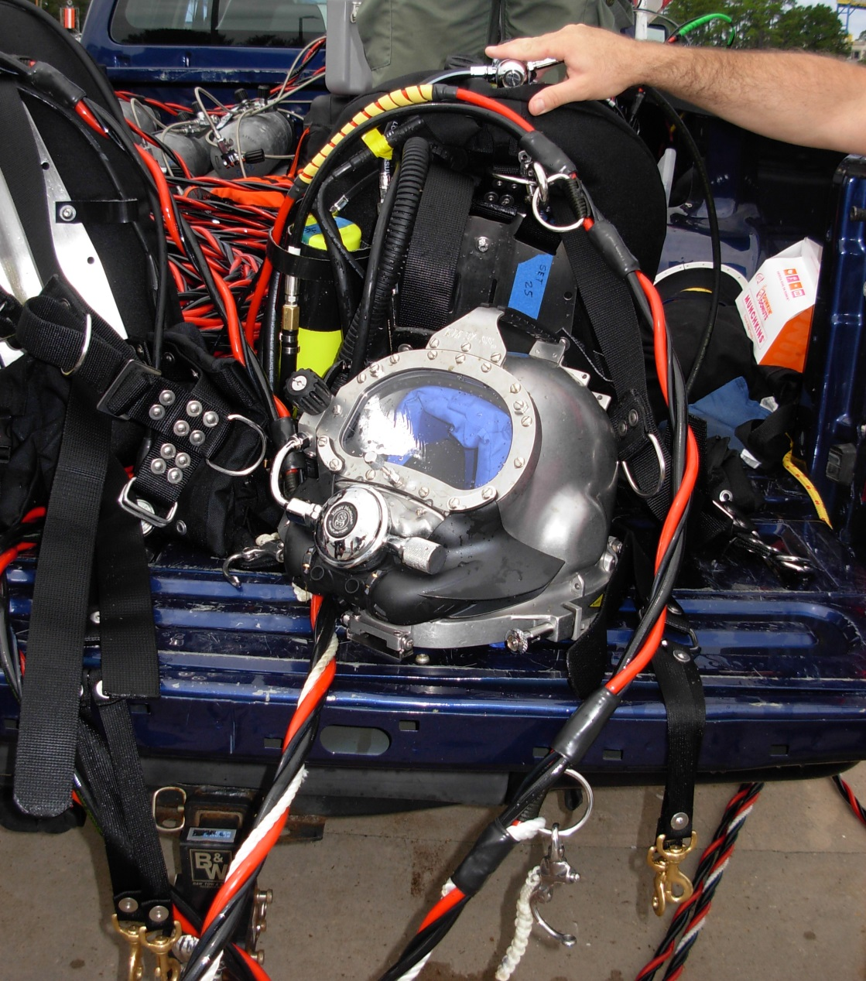
KIRBY MORGAN HELMET MODELS
17A/B, 17C, 17K, 27, KM-37, 47, 57, 77,97
POST DIVE CLEANING, MAINTENANCE, AND INSPECTION CHECKLIST
APPENDIX A2.6

Slide 2
KIRBY MORGAN DIVE SYSTEMS INCORPORATED MAINTENANCE AND REPAIR TECHNICIAN TRAINING
Only selected Dive Lab trained Technicians are authorized to teach the Technicians Course.
Only Dive Lab authorized Technicians may teach the KMDSI Operator/User Course.
Course curriculum must be presented within the guidelines set-up in the repair technician’s guide and slide show.
Kirby Morgan, SuperLite, Band Mask, KMB Band Mask, EXO, SuperMask, SuperFlow, and Rex are all registered trademarks of Kirby Morgan Dive Systems, Inc. Use of these terms to describe products that are not manufactured by KMDSI is not permitted without written permission from KMDSI.
© Copyright 1970-2009 Kirby Morgan Dive Systems, Inc. All rights reserved. This manual is made available for the express use of owner of this Kirby Morgan product. No part of this manual may be reproduced, stored in any retrieval system, or transmitted, or used in any form or by any means, whether graphic, electronic, mechanical, photocopy, or otherwise by technology known or unknown, without the prior written permission of Kirby Morgan Dive Systems, Inc.
THIS SLIDE SHOW IS FOR THE USE OF KIRBY MORGAN CUSTOMERS AND USERS OF KIRBY MORGAN DIVING EQUIPMENT ONLY. IT IS FREE OF CHARGE FROM OUR WEB SITES FOR THAT USE ONLY UNTIL FURTHER NOTICE. This material may not be reproduced for resale or given to unauthorized organizations or persons. THIS MATERIAL MAY NOT BE CHANGED OR MODIFIED WITHOUT WRITTEN PERMISSION.
Prepared by Dive Lab®, Inc. 1415 Moylan Road, Panama City Beach, FL 32407 USA
Telephone: (850) 235-2715 Web Site: www.divelab.com E-Mail: divelab@aol..com
Document #TechTrnG 03101

Slide 3
POST DIVE CLEANING, MAINTENANCE, AND INSPECTION
Post dive cleaning and inspection should be performed at the end of daily diving operations or at least every 24 hours during continuous diving operation

Slide 4
POST DIVE CLEANING, MAINTENANCE, AND INSPECTION
Helmet(s) being used in polluted waters, or extreme environments, will require more frequent cleaning, inspection and maintenance

Slide 5
POST DIVE CLEANING, MAINTENANCE, AND INSPECTION
During removal of components for inspection, O-rings and other consumable items may be reused, providing they are clean and a visual inspection does not reveal any damage or deterioration

Slide 6
POST DIVE CLEANING, MAINTENANCE, AND INSPECTION
This cleaning and maintenance schedule is recommended for all KM helmets, band masks and should be performed at least on a DAILY basis
Detailed instructions are located in the applicable O & M Manual

Slide 7
POST DIVE CLEANING, MAINTENANCE, AND INSPECTION
Disconnect and cap or tape Helmet Gas Connections and disconnect the communication wires
Cap or tape Umbilical End

Slide 8
POST DIVE CLEANING, MAINTENANCE, AND INSPECTION
Wash the exterior surface of the Helmet with a solution of mild detergent and fresh water, then rinse
Soaking helmet is soap and water works best

Slide 9
POST DIVE CLEANING, MAINTENANCE, AND INSPECTION
Rinse in fresh water
Soaking in fresh water will ensure all the soap is rinsed off
Inspect for signs of damage

Slide 10
POST DIVE CLEANING, MAINTENANCE, AND INSPECTION
Remove the Head Cushion Assembly, Inspect for damage
If the Head Cushion has gotten wet with perspiration or water, clean and hang-up for drying or airing

Slide 11
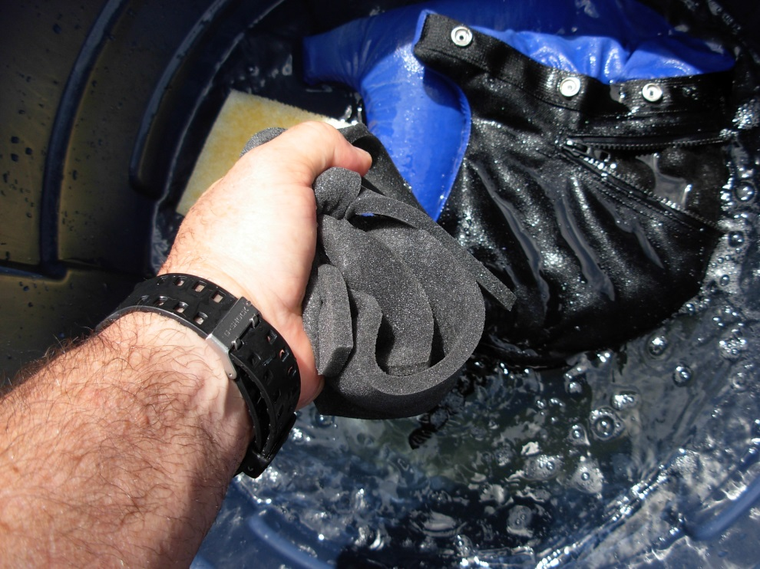
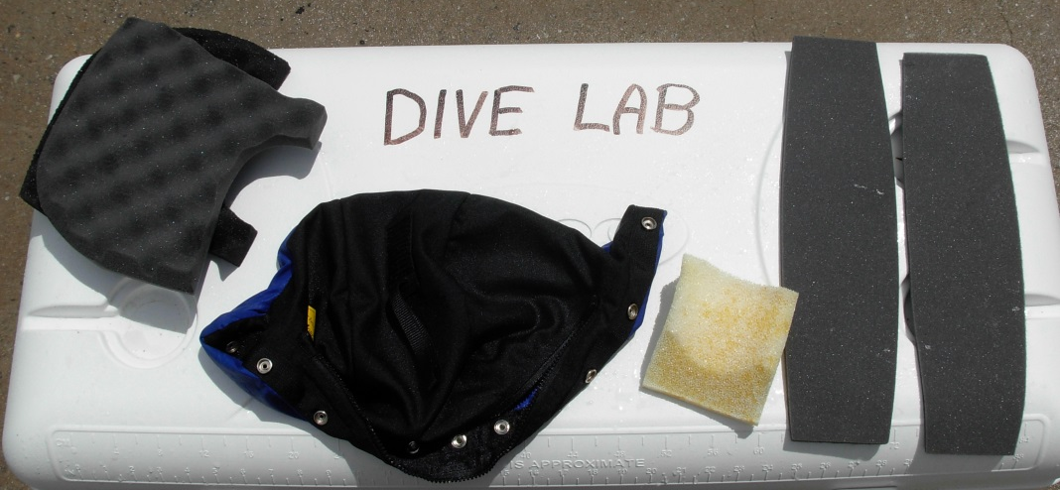
POST DIVE CLEANING, MAINTENANCE, AND INSPECTION
Wash helmet liner in soap and water
Do not machine wash or dry, machines can destroy liner or foam
Rinse in fresh water and drip dry only

Slide 12
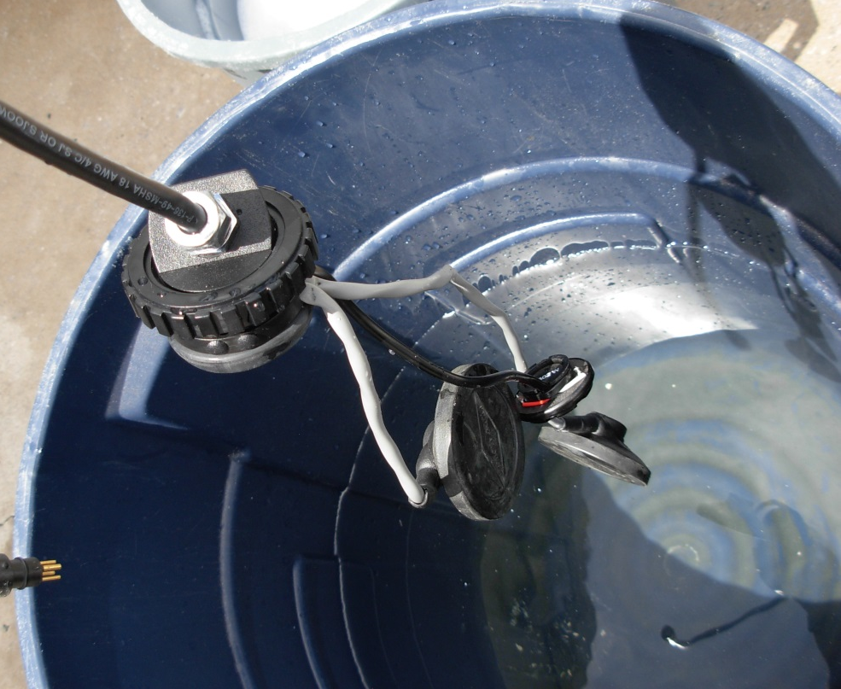
POST DIVE CLEANING, MAINTENANCE, AND INSPECTION
Dislodge the earphones, If the interior of the Helmet and Liner has gotten wet, remove the earphone protective covers, wash with mild detergent solution, rinse with fresh water and allow to dry

Slide 13
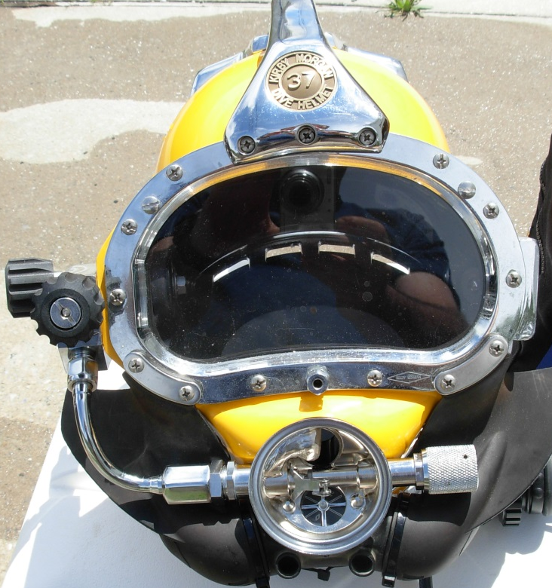
POST DIVE CLEANING, MAINTENANCE, AND INSPECTION
Remove the Demand Regulator Clamp, Cover, and Diaphragm Assembly, Wash the interior of the Demand Regulator with mild detergent and fresh water, then rinse thoroughly

Slide 14
POST DIVE CLEANING, MAINTENANCE, AND INSPECTION
Lay out all components
Allow enough time to dry before putting helmet away

Slide 15
POST DIVE CLEANING, MAINTENANCE, AND INSPECTION
For sanitizing procedures, refer to “Appendix 5: Quick Sanitizing Procedure”
Rotate Regulator Adjustment Knob fully out (counter clockwise)
Close the Emergency Supply and Steady Flow Valves

Slide 16
POST DIVE CLEANING, MAINTENANCE, AND INSPECTION
Clean the Neck Dam and Neck Clamp and Latch Catch (SL-17A/B Assembly with a mild detergent solution
Operate the Neck Clamp and Latch Catch (SL-17A/B), rinse with fresh water
Clean the Neck Ring, and Pull Pin Assemblies (SL17K, 17C, 27, KM-37, 47, 57, 77) with mild detergent solution, thoroughly rinse with fresh water

Slide 17
POST DIVE CLEANING, MAINTENANCE, AND INSPECTION
Wipe all surfaces with a clean, dry towel to remove water droplets. Allow to air dry.
Cap (or bag and tape) the Emergency Gas Whip on the First Stage Regulator
Wash the exterior of all EGS components, the First Stage Regulator, the Gas Cylinder, the Submersible Pressure Gauge, and the Harness Assembly with a mild detergent solution and rinse with fresh water

Slide 18
POST DIVE CLEANING, MAINTENANCE, AND INSPECTION
Note any damage or discrepancies found during cleaning

Slide 19
POST DIVE CLEANING, MAINTENANCE, AND INSPECTION
KMDSI highly recommends that a certified KMDSI Repair Technician make all repairs and that only genuine KMDSI repair and replacement parts be used
Owners of KMDSI products that elect to do their own repairs and inspections should only do so if they possess the knowledge and experience
All inspections, maintenance, and repairs should be completed using the appropriate KMDSI Operations and Maintenance Manual(s)

Slide 20
POST DIVE CLEANING, MAINTENANCE, AND INSPECTION
Persons performing repairs should retain all replacement component receipts for additional proof of maintenance history
Should any questions on procedures, components, or repairs arise, please contact Kirby Morgan Dive Systems, Inc., by telephone at (805) 928-7772 or via e-mail at info@kirbymorgan.com, or contact Dive Lab, Inc., by telephone at (850) 235-2715 or via e-mail at divelab@aol.com.

