Slide 1
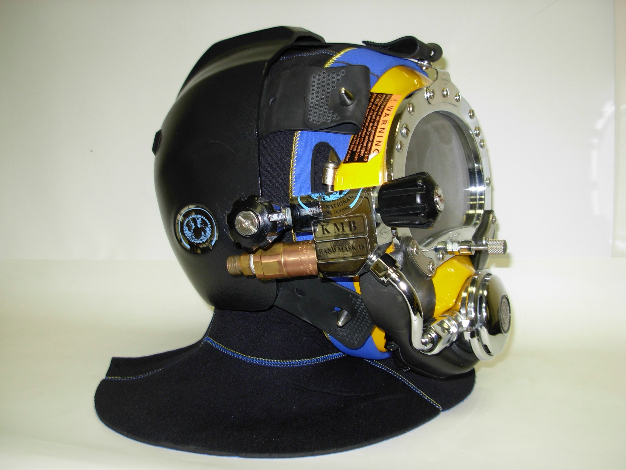
KMB 18/28 (BANDMASK) USER, OPERATOR COURSE

Slide 2
KIRBY MORGAN DIVE SYSTEMS INCORPORATED MAINTENANCE AND REPAIR TECHNICIAN TRAINING
Only selected Dive Lab trained Technicians are authorized to teach the Technicians Course.
Only Dive Lab authorized Technicians may teach the KMDSI Operator/User Course.
Course curriculum must be presented within the guidelines set-up in the repair technician’s guide and slide show.
Kirby Morgan, SuperLite, Band Mask, KMB Band Mask, EXO, SuperMask, SuperFlow, and Rex are all registered trademarks of Kirby Morgan Dive Systems, Inc. Use of these terms to describe products that are not manufactured by KMDSI is not permitted without written permission from KMDSI.
© Copyright 1970-2009 Kirby Morgan Dive Systems, Inc. All rights reserved. This manual is made available for the express use of owner of this Kirby Morgan product. No part of this manual may be reproduced, stored in any retrieval system, or transmitted, or used in any form or by any means, whether graphic, electronic, mechanical, photocopy, or otherwise by technology known or unknown, without the prior written permission of Kirby Morgan Dive Systems, Inc.
THIS SLIDE SHOW IS FOR THE USE OF KIRBY MORGAN CUSTOMERS AND USERS OF KIRBY MORGAN DIVING EQUIPMENT ONLY. IT IS FREE OF CHARGE FROM OUR WEB SITES FOR THAT USE ONLY UNTIL FURTHER NOTICE. This material may not be reproduced for resale or given to unauthorized organizations or persons. THIS MATERIAL MAY NOT BE CHANGED OR MODIFIED WITHOUT WRITTEN PERMISSION.
Prepared by Dive Lab®, Inc. 1415 Moylan Road, Panama City Beach, FL 32407 USA
Telephone: (850) 235-2715 Web Site: www.divelab.com E-Mail: divelab@aol..com
Document #TechTrnG 03101

Slide 3
KMB 18/28 (BANDMASK) Introduction
This course provides guidance on how to use the KMB 18 and 28
Use of these masks will vary with the type of work and environmental conditions
The basic procedures of donning and removing masks will be similar for every job

Slide 4
KMB 18/28 (BANDMASK) Introduction
This class is intended for divers who have previously been commercially or militarily trained in the use of commercial dive equipment

Slide 5
KMB 18/28 (BANDMASK) Introduction
Divers trained in the use of previous Kirby Morgan masks; i.e., KMB 8, 9, 10, Navy MK 1 mask, Navy MK 21 helmet, Navy Mk 22 mask, or SuperLite helmets, will find that KMB 18/28 Band Masks have the breathing system controls located in the same position and operations are similar

Slide 6
KMB 18/28 (BANDMASK) Introduction
Demand regulator and side block components are designed to work with pressures as low as 90 psig over bottom when diving to depths of 60 fsw or shallower, and as high as 225 psig O.B. when diving deeper
This wide operating range allows flexibility when using various gas supply systems

Slide 7
KMB 18/28 (BANDMASK) MAINTENANCE AND INSPECTION
A2.1 inspection and maintenance should be performed at least annually
Frequency of maintenance is dictated by condition revealed during daily/monthly inspection
Monthly inspections determine necessity for overhaul with more accuracy than simply placing a number of hours of use

Slide 8
KMB 18/28 (BANDMASK) MAINTENANCE AND INSPECTION
Masks being used in polluted waters, or extreme environments, will require more frequent inspection
KM18/28 band masks should not be used for Polluted/contaminated waters
Hamlets (KM37) are preferred for Polluted/contaminated waters

Slide 9
KMB 18/28 (BANDMASK) MAINTENANCE AND INSPECTION
Side block, Regulator are the same as on the KM37/SL27, parts are interchangeable
KMB28’s manufactured before 2004 used small bore super flow regulator (SL17 reg)
Lexan Face port on KMB28 is smaller, All other KM face ports, port retainers are the same size

Slide 10
Old Plastic Frame Band Masks
Older KMB 28’s, 9’s, and 10’s use smaller face port retainers
Tab between side block and port retainer
Newer face port retainers will NOT fit
This type of frame is no longer manufactured

Slide 11
KMB 18/28 Features
Head Harness (Spider) keeps the mask in place on the divers head. The neoprene rubber spider has adjustment holes for varying the tension of the harness
Hood/Face Seal provides the diver a comfortable thermal barrier around his head as well as pockets for earphones

Slide 12
KMB 18/28 Features
Steady Flow Valve provides an additional flow of air into the mask for ventilation and defogging
Auxiliary Valve (EGS) supplies backup breathing gas to the diver

Slide 13
KMB 18/28 Features
Gas Supply Non-Return Valve prevents loss of gas pressure in the event of umbilical damage, preventing a "squeeze”
Communications Connections can be either bare wire posts or a waterproof connector. The waterproof type is recommended when a "round robin" or diver/tender both mics "on" communications system is used

Slide 14
KMB 18/28 Features
Tri-Valve Exhaust Whisker which retrofits to Band Masks, has less breathing resistance than the older single valve exhaust while providing an extremely dry hat

Slide 15
KMB 18/28 Features
Demand Regulators The SuperFlow350® KMB 18 and KMB 28 regulator provides easy breathing for hard work
Water Exhaust automatically keeps water drained from the mask

Slide 16
KMB 18/28 Features
Silicone Oral Nasal Mask is made of a superior silicone material which is hypo-allergenic
Nose Block Device allows the diver to block the nose to equalize ears

Slide 17
KMB 18/28 Pre-dive inspection
KMB Band Masks are designed to fit most divers
No special pre-dive adjustment must be made other than securing the spider with the proper tension for the diver’s head

Slide 18
KMB 18/28 Custom Hood
Divers with smaller heads:
a custom made hood can be specially ordered
Contact your Kirby Morgan dealer for more information on this product

Slide 19
KMB 18/28 Pre-Dive Inspection
Demand Regulator: cover assembly should not be dented and the purge button must work
Bent tube: no dents or kinks in the assembly
Face port: must be in good condition

Slide 20
KMB 18/28 Pre-Dive Inspection
Spider must be in good condition
Rubber must not be torn or cracked
All five legs present

Slide 21
KMB 18/28 Pre-Dive Inspection
Loosen band screws
Loosen band keeper screws (if installed)

Slide 22
KMB 18/28 Pre-Dive Inspection
Remove the Earphones from their pockets in the Hood

Slide 23
KMB 18/28 Pre-Dive Inspection
Hood and Face seal: Good condition with no tears or rips, tears in the face seal can cause the regulator to free flow
Face seal must be properly glued to the hood
Lubricate zipper

Slide 24
KMB 18/28 Pre-Dive Inspection
Visually inspect all metal parts of the Band Assembly and band keeper components, including the Band Screws, for damage
Replace if necessary
Guidance O & M Manual

Slide 25
KMB 18/28 Pre-Dive Inspection
Visually inspect mask exterior and interior
Loose or missing fasteners
Obvious signs of damage
Cracks, gouges, and/or depressions

Slide 26
KMB 18/28 FRAME ASSEMBLY
KMB 18 has a Fiberglass frame with comfort insert
KM28, KMB 9, 10 and MK1 frames are made of ABS plastics

Slide 27
KMB 28 FRAME ASSEMBLY
Cracks in KM28, 9, 10 frames can not be repaired
Navy MK 1 frames will except KM parts

Slide 28
KMB 28 FRAME ASSEMBLY
KMB 28 frames should not be use for extended burning/welding ops
Face port inserts deteriorate over time due to electrolysis
Inserts cannot be replaced on plastic frames

Slide 29
KMB 18 FRAME ASSEMBLY
KMB 18 Frame is repaired the same way as the KM Fiberglass Helmets
On the KMB 18 any gouges in the fiberglass shell deeper than 1/16” should be repaired

Slide 30
KMB 18 FRAME ASSEMBLY
Fiberglass and gel coat repairs MUST be completed by a technician that has received certification for Helmet Shell repairs by KMDSI or Dive Lab, Inc.
Any cracks or depressions with fractures must be checked by an Authorized KMDSI Repair Facility

Slide 31
KMB 18/28 MASK ASSEMBLY
Remove covers from earphones
Remove microphone from the Oral Nasal Mask
Inspect and repair/replace as necessary
Perform a communications check

Slide 32
KMB 18/28 MASK ASSEMBLY
Remove the Nose Clearing Device, Clean and inspect the Nose Clearing Pad and Shaft
Inspect Nose Clearing Device, O-Rings
Inspect Oral Nasal Mask and Oral Nasal Valve as an assembly
Clean, inspect Mask and Valve Assembly for damage
Guidance O & M Manual

Slide 33
KMB 18 MASK ASSEMBLY
Remove the Comfort Insert [KMB-18 only]
Clean and inspect the Comfort Insert for damage and/or deterioration

Slide 34
KMB 28 MASK ASSEMBLY
The KM28, 9, and 10 do not have comfort inserts

Slide 35
KMB 18 MASK ASSEMBLY
Remove the Main Exhaust Valve Cover and inspect Main Exhaust/Dewatering Valve
Inspect Seat for damage and/or contamination

Slide 36
KMB 28, 9, 10, MK1 (BANDMASK) MASK ASSEMBLY
Water dump valve assemblies are molded into Plastic frames
If any damage is percent it cannot be repaired (replace frame)

Slide 37
KMB 18/28 MASK ASSEMBLY
Tri-Valve exhaust system will fit KMB 18, 28, 9, and 10
No frame modifications required

Slide 38
KMB 18/28 Band Keeper Kit
Introduced in 2003
Will fit all KMB masks
Requires new hood
Bands are inserted into hood

Slide 39
KMB 18/28 Band Keeper Kit
Prevents hood retaining band from separating from frame
All masks manufactured after 2004 come with kit installed

Slide 40
KMB 18/28 Band Keeper Kit
KM Technicians should install kits on all band masks manufactured before 2004
Kit #525-172

Slide 41
KMB 18/28 Ordinal Hood
Oct 2009 KM stopped manufacturing old style hoods
Old style hoods should be Replaced

Slide 42
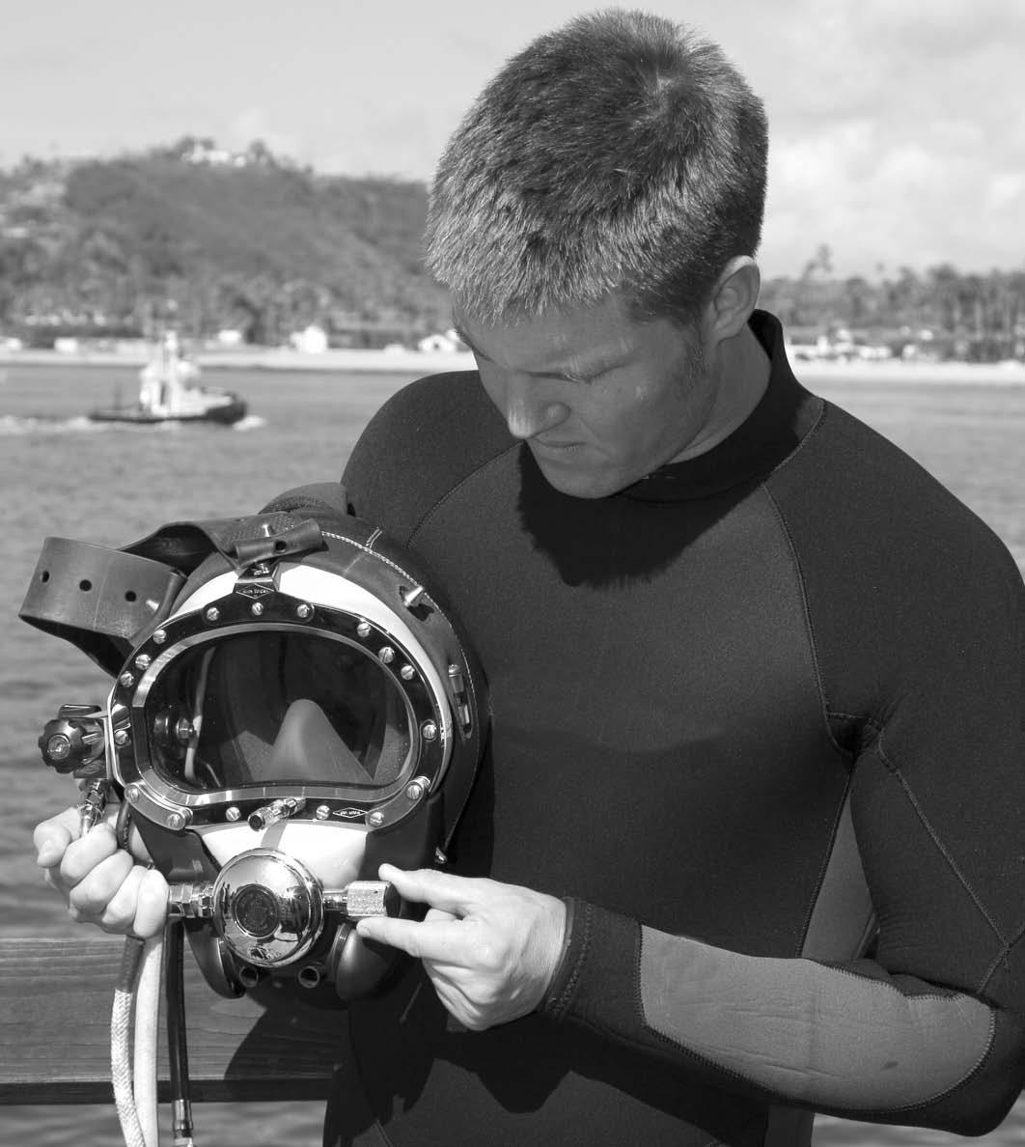
KMB 18/28 Pre-Dive Check all moving parts
Regulator adjustment knob
Defogger control knob
Emergency (EGS) knob
Nose block device

Slide 43
KMB 18/28 Pre-Dive
Pre-dive checks on air train are identical to KM helmets
Connect EGS System
Main Gas Umbilical
Connect comms

Slide 44
KMB 18/28 Pre-Dive
Hold mask to face and check breathing
Check communications

Slide 45
KMB 18/28 Donning and Removing Mask
All donning procedures must be done by the diver until he is thoroughly at home with the mask, this will train for familiarity
Tender must be present to assist the diver and check to ensure that the diver has properly donned his equipment
It is impossible for the diver to see whether he is properly dressed in once the mask is on

Slide 46
KMB 18/28 Donning and Removing Mask
Open the regulator adjustment knob and the defogger control knob for a steady flow from both just prior to the diver dressing into the mask

Slide 47
KMB 18/28 Donning and Removing Mask
With the diver holding the mask, the tender should now connect the quick disconnect fittings for the bailout supply

Slide 48
KMB 18/28 Donning and Removing Mask
To prepare the mask for donning by yourself, close the zipper until only the last six inches are open
Fasten every “leg” of the spider except the one on the bottom left
Pick the mask up with both hands and fold the spider over the front of the mask

Slide 49
KMB 18/28 Donning and Removing Mask
Pull the hood onto your head and close the zipper, taking care not to catch your hair in the zipper
You will need to support the mask with your right hand as you do this
Use your left hand to close the zipper

Slide 50
KMB 18/28 Donning and Removing Mask
While you continue to support the mask with your right hand, use your left hand to fasten the remaining leg of the spider to your left
As a standby diver, it is essential for you to be able to don your mask yourself during an emergency

Slide 51
KMB 18/28 Donning and Removing Mask
For most divers:
mask is most comfortable when the spider is adjusted so that the top three legs of the spider are tighter than the bottom two

Slide 52
KMB 18/28 Donning and Removing Mask
If you have an “average” size head, the adjustment most divers find comfortable is three holes back on the top three legs, and two holes back on the two bottom legs of the spider

Slide 53
KMB 18/28 Donning and Removing Mask
You may find a different adjustment to be more comfortable depending on the size of your head
Mask should feel comfortably snug against your face out of the water
There will be some compression of the face seal when it is adjusted properly

Slide 54
KMB 18/28 Donning and Removing Mask
The weight of the mask is heavy out of the water, it will be almost unnoticeable underwater
Your tender may assist you in donning your mask if you prefer
The procedure is the same as donning by yourself, except that your tender will close the zipper on the hood and fasten the spider

Slide 55
KMB 18/28 Donning and Removing Mask
You will still need to support the weight of the mask while your tender fastens you in
To help keep the bib of your hood from floating up, you tuck the bib of the hood under your harness

Slide 56
KMB 18/28 Testing the Breathing System
Test the defogger system by turning on and off the defogger control knob (steady-flow)
Regulator should be adjusted by turning the adjustment knob out until a slight free-flow starts, then back in until the flow just stops

Slide 57
KMB 18/28 Testing the Breathing System
Demand regulator checked for proper function: breathe in and out
Inhalation and exhalation effort should be nearly unnoticeable
Press in on the purge button in the regulator cover: Should produce a strong burst of breathing gas

Slide 58
KMB 18/28 Pre-Dive
It is the responsibility of the diving supervisor to always ensure that all pre-dive checks have been properly conducted, prior to allowing the diver to enter the water
For the most current pre-dive checks, consult the Dive Lab web site (www.divelab.com)

Slide 59
KMB 18/28 Summary
Maintenance & Inspection
Features
Pre-Dive inspection

Slide 60
KMB 18/28 Summary
KMB 18 fiberglass frame
KMB 28 plastic frame
Band Keeper Kit
Donning Mask

Slide 61



