Slide 1
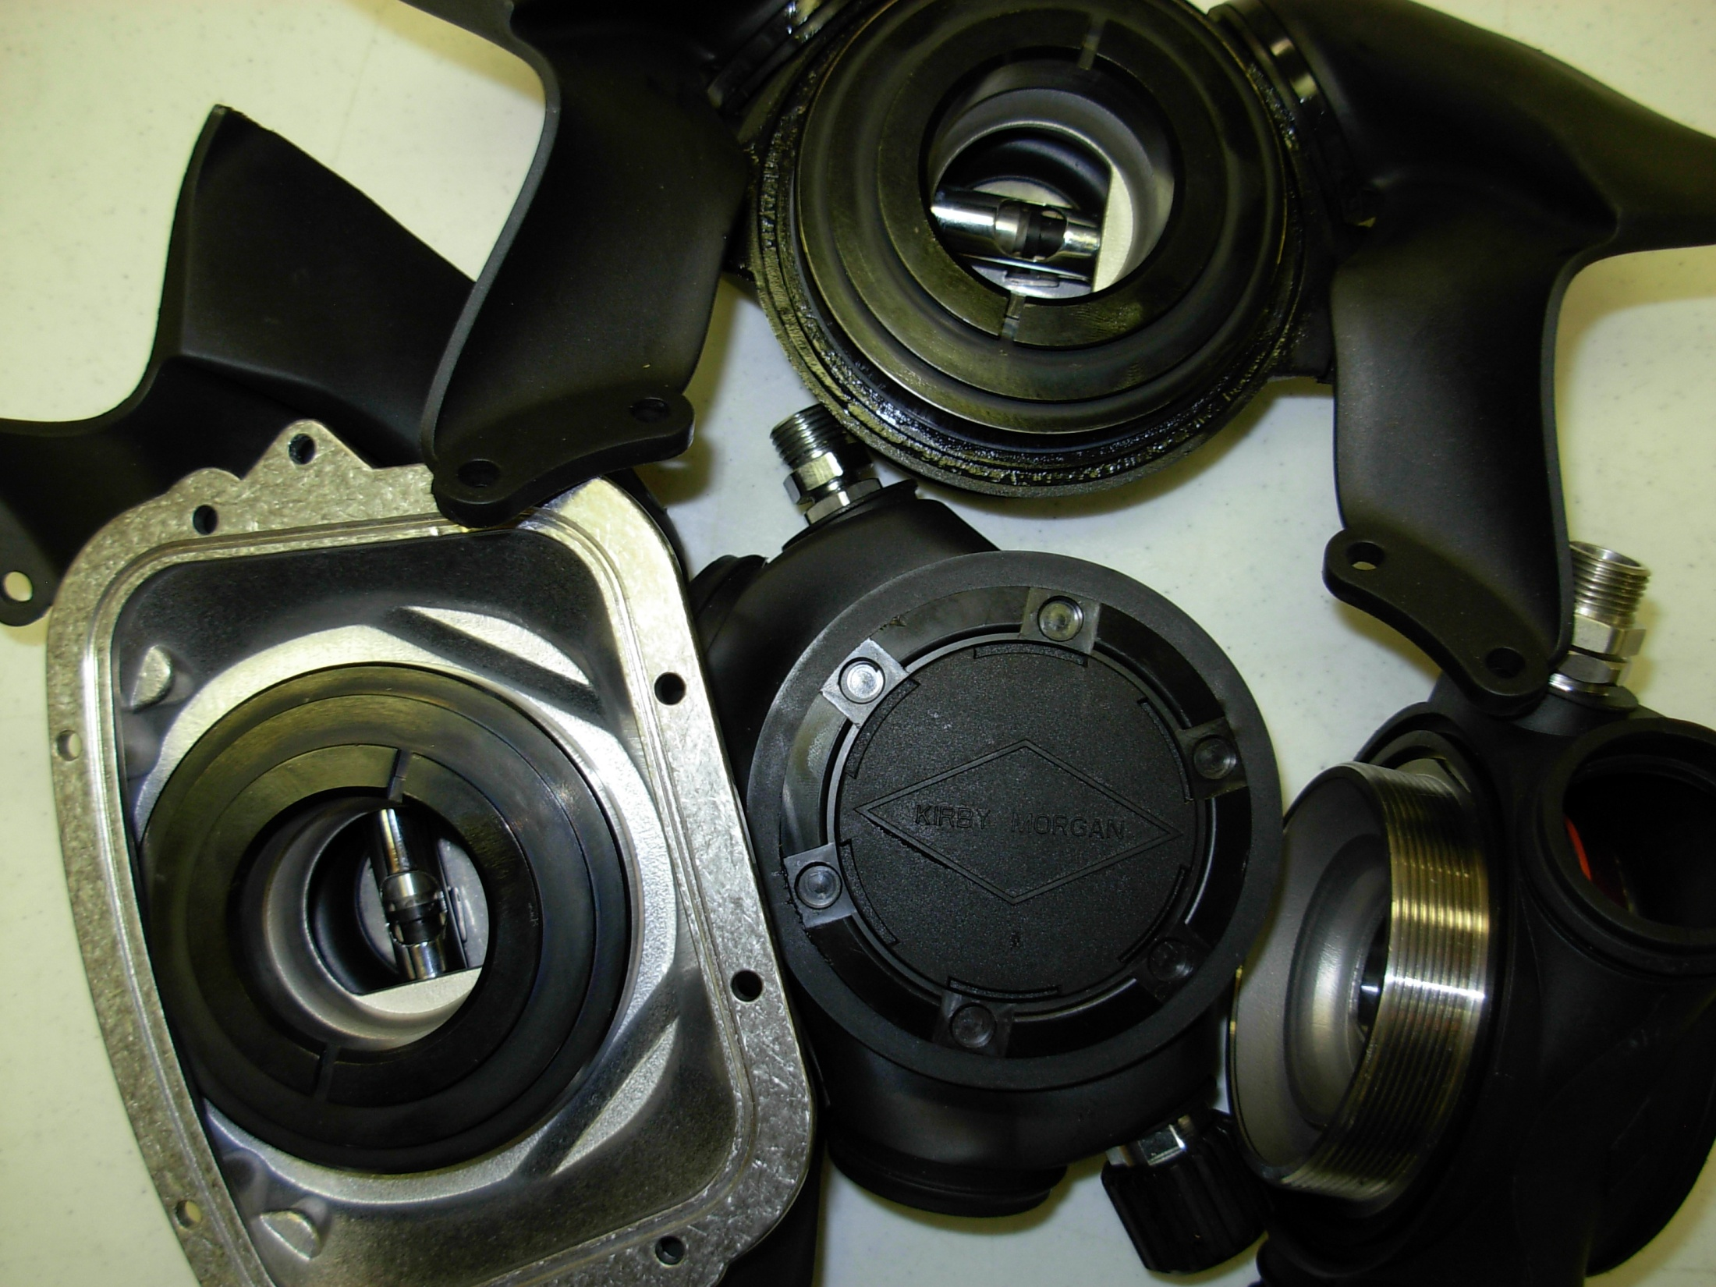
REX Regulator (KM47/77)

Slide 2
KIRBY MORGAN DIVE SYSTEMS INCORPORATED MAINTENANCE AND REPAIR TECHNICIAN TRAINING
Only selected Dive Lab trained Technicians are authorized to teach the Technicians Course.
Only Dive Lab authorized Technicians may teach the KMDSI Operator/User Course.
Course curriculum must be presented within the guidelines set-up in the repair technician’s guide and slide show.
Kirby Morgan, SuperLite, Band Mask, KMB Band Mask, EXO, SuperMask, SuperFlow, and Rex are all registered trademarks of Kirby Morgan Dive Systems, Inc. Use of these terms to describe products that are not manufactured by KMDSI is not permitted without written permission from KMDSI.
© Copyright 1970-2009 Kirby Morgan Dive Systems, Inc. All rights reserved. This manual is made available for the express use of owner of this Kirby Morgan product. No part of this manual may be reproduced, stored in any retrieval system, or transmitted, or used in any form or by any means, whether graphic, electronic, mechanical, photocopy, or otherwise by technology known or unknown, without the prior written permission of Kirby Morgan Dive Systems, Inc.
THIS SLIDE SHOW IS FOR THE USE OF KIRBY MORGAN CUSTOMERS AND USERS OF KIRBY MORGAN DIVING EQUIPMENT ONLY. IT IS FREE OF CHARGE FROM OUR WEB SITES FOR THAT USE ONLY UNTIL FURTHER NOTICE. This material may not be reproduced for resale or given to unauthorized organizations or persons. THIS MATERIAL MAY NOT BE CHANGED OR MODIFIED WITHOUT WRITTEN PERMISSION.
Prepared by Dive Lab®, Inc. 1415 Moylan Road, Panama City Beach, FL 32407 USA
Telephone: (850) 235-2715 Web Site: www.divelab.com E-Mail: divelab@aol..com
Document #TechTrnG 03101

Slide 3
REX Regulator (KM47/77)
The breathing system on all Kirby Morgan helmets and masks is simple and highly reliable
The fact that they can continue to operate when the components are not in a well-maintained condition can cause divers to become complacent about maintenance
Your life depends on the correct function of this equipment!

Slide 4
REX Regulator (KM47/77)
The REX regulator is simple to maintain, like any type of life support equipment, it requires regular periodic maintenance to function properly
All parts disassembled should be thoroughly cleaned
Components that require the use of lubricants, sealing and thread locking compounds should also be serviced

Slide 5
REX Regulator (KM47/77) Disassembly for Cleaning
Remove tie wraps from whisker wings
Remove whisker valve assembly from each side of exhaust body, inspect
During regular cleaning and inspection, the whisker valves do not need to be removed from plastic exhaust valve seats
Remove regulator cover ring, cover, washer, and diaphragm

Slide 6
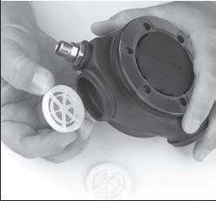
REX Regulator (KM47/77) Disassembly

Slide 7
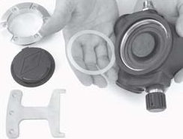
REX Regulator (KM47/77) Disassembly

Slide 8
REX Regulator (KM47/77) Disassembly
Remove each plastic valve cage with the silicone valve still installed
Clean and inspect valve assemblies
Silicone valves should be smooth and flat, when lifted away from seat, it should snap firmly into place
The seats should be smooth and straight

Slide 9
REX Regulator (KM47/77) Set-up/Adjustment
Screw the regulator adjustment knob in clockwise all the way, then rotate it out counter clockwise three turns
Slowly rotate the inlet nipple in clockwise until a slight movement is noticed at the roller lever then stop
Lightly tighten the jam nut to prevent movement of the nipple tube

Slide 10
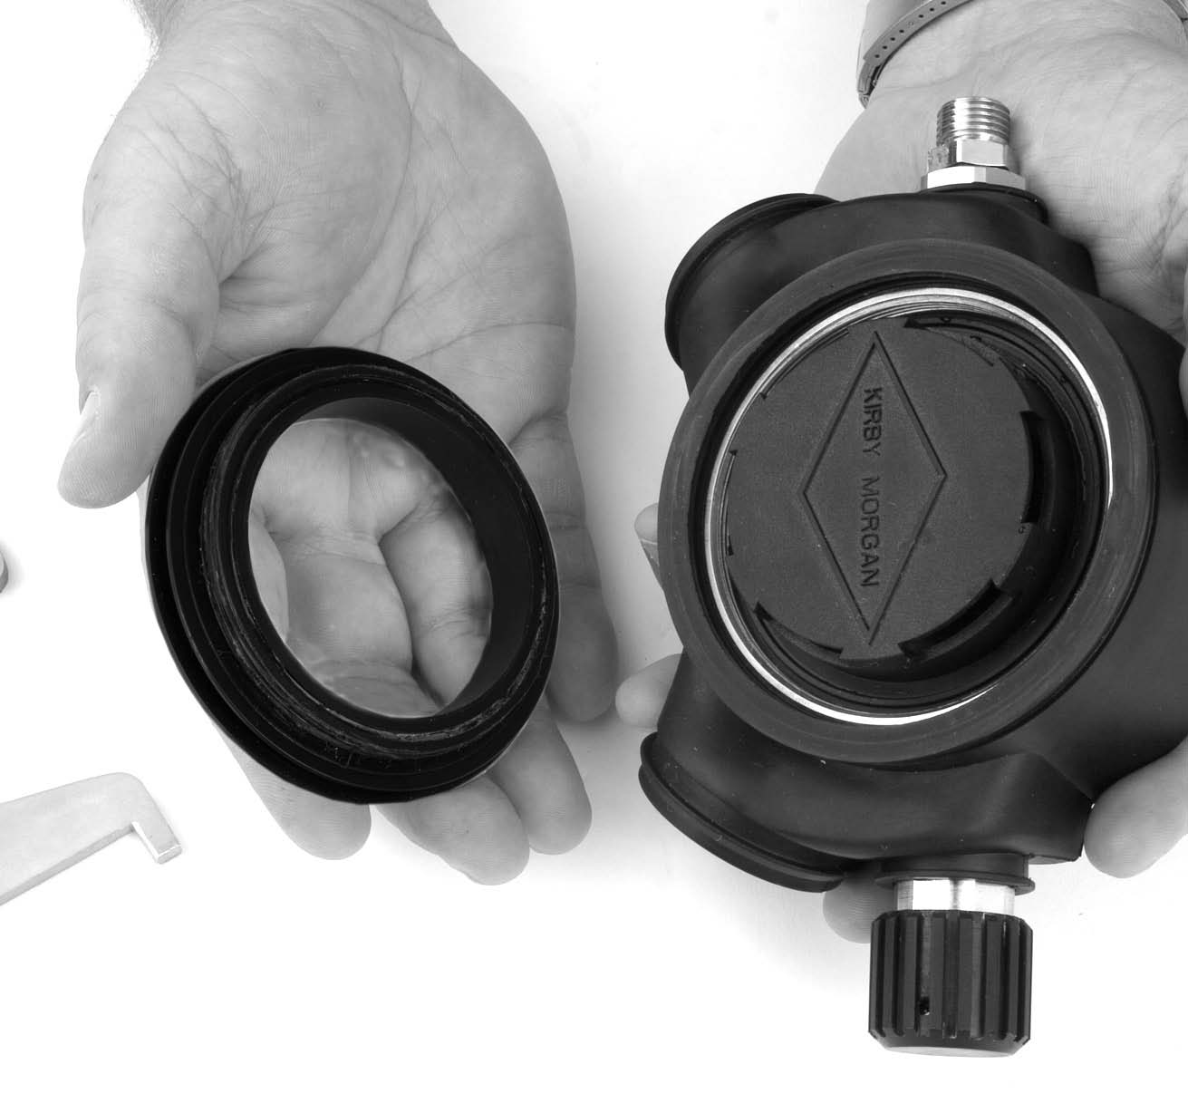
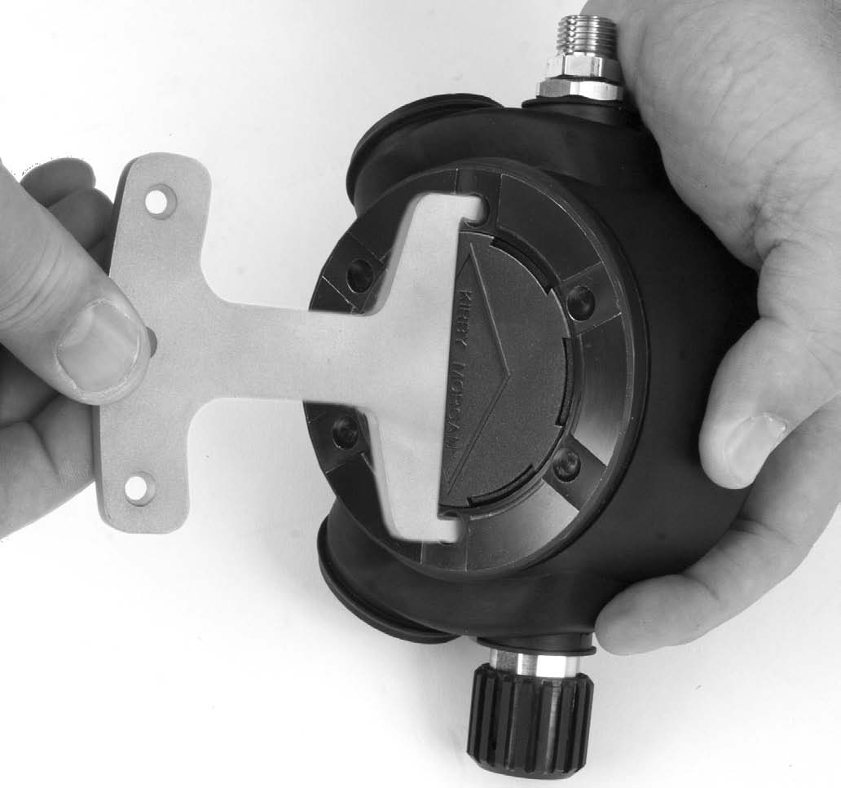
REX Regulator (KM47/77) Set-up/Adjustment
Install diaphragm, thrust washer, flexible cover and cover ring to the regulator assembly using the special spanner wrench

Slide 11
REX Regulator (KM47/77) Set-up/Adjustment
Adjustment of the demand regulator should be done using a supply pressure of between 135-140 p.s.i.g.
Re-check adjustment knob position by completely turning it in, then backing it out 3 full turns
Attach a air source to either umbilical adapter at the one way valve, or EGS valve
Slowly pressurize helmet, then open the supply fully

Slide 12
REX Regulator (KM47/77) Set-up/Adjustment
The cover should travel inward 1/4 - 5/16 of an inch before gas flow is heard
Once desired travel is achieved, tighten lock nut against regulator body using two 13/16” wrenches
Make certain bent tube fitting is snug against the hex on nipple tube by again using two 13/16” wrenches
Re-check purge adjustment, re-adjust if needed

Slide 13
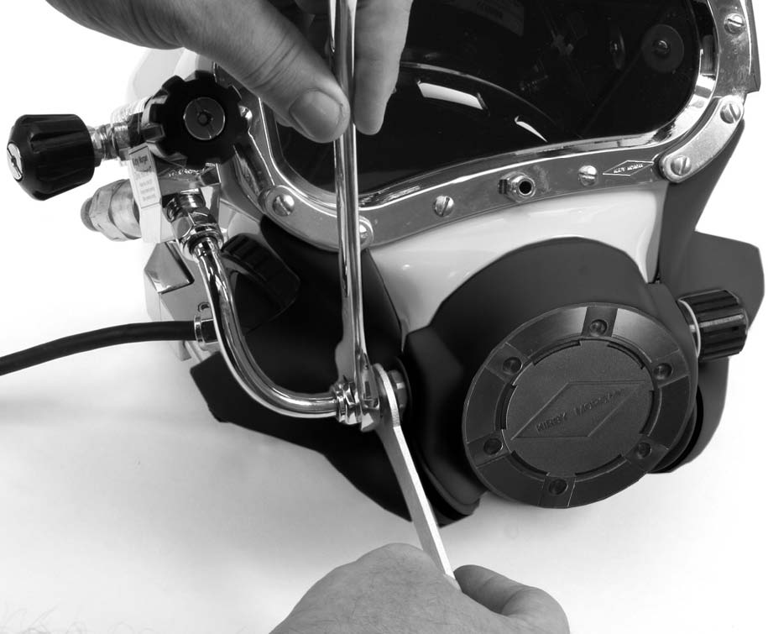
REX Regulator (KM47/77) Set-up/Adjustment
Low pressure air source must be adjustable over a range from 135-140 p.s.i.
With the air supply connected, turn the adjustment knob all the way out and back in 3 turns

Slide 14
REX Regulator
Regulator is adjusted and ready for use

Slide 15
Summary
Always refer to Operations & maintenance manual for adjustment procedures
Inspection
Adjustments

Slide 16



